Slide 1
Does The Book of Mormon Provide Accurate Linguistic, Cultural and Archaeological Information about Israel at the time of Lehi?
By Lyle L. Smith

Slide 2
“And if they are not the words of Christ, judge ye: for Christ will shew unto you, with power and great glory, that they are his words at the last day.”
2 Nephi 15:13

Slide 3
2 Nephi 8:7 Behold, my soul delighteth in proving unto my people the truth of the coming of Christ:
2 Nephi 8:12 And my soul delighteth in proving unto my people, that save Christ should come, all men must perish.
DC 17:2e and is confirmed to others by the ministering of angels, and is declared unto the world by them, proving to the world that the Holy Scriptures are true,

Slide 4
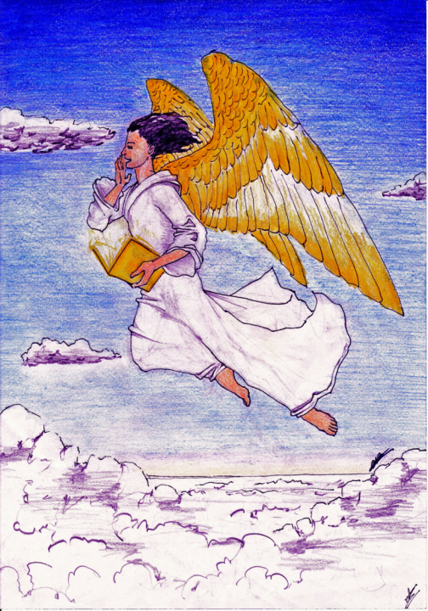
And I saw another angel fly in the midst of heaven, having the everlasting gospel to preach unto them that dwell on the earth, to every nation, and kindred, and tongue and people.

Slide 5
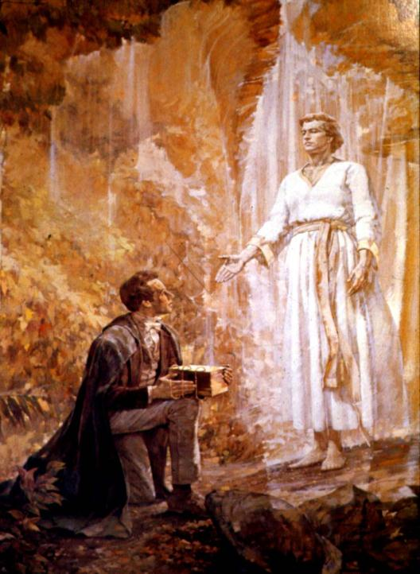

Slide 6
Some year ago I was needing to write an article about the archaeology of The Book of Mormon. I had several topics to write about but could not decide which was best. After finally praying about it, the Lord called to my attention articles about an archeological dig in Southern Israel. It was published in the magazine Biblical Archaeology Review (BAR). Sherrie read the articles to me on our way to work, and as she did, the Spirit bore witness that this was the material the Lord wanted me to write about.

Slide 7
When The Book of Mormon was published in 1830 in its pages were a number of cultural and linguistic statements that related to Israel at the time of Lehi about 600 B.C.. These statements were highly disputed and not accepted as true by non believers. Today we are going to look a six very controversial statements and see if they were accurate or not.

Slide 8
Book of Mormon statements:
1. Military commanders kept written records.
2. Temples were built outside Jerusalem.
3. Hebrew scribes wrote history in Egyptian.
4. Mulek is a title, meaning the “son of a king.”
5. The use of “and now” as a standard opening in writing.
6. Religious records were written on metal plates.
According to The Book of Mormon all the above was happening before 600 BC.

Slide 9
But first we need to go to an edition of BAR, May/June 1985, which explains how archaeological research can validate cultural history.

Slide 10
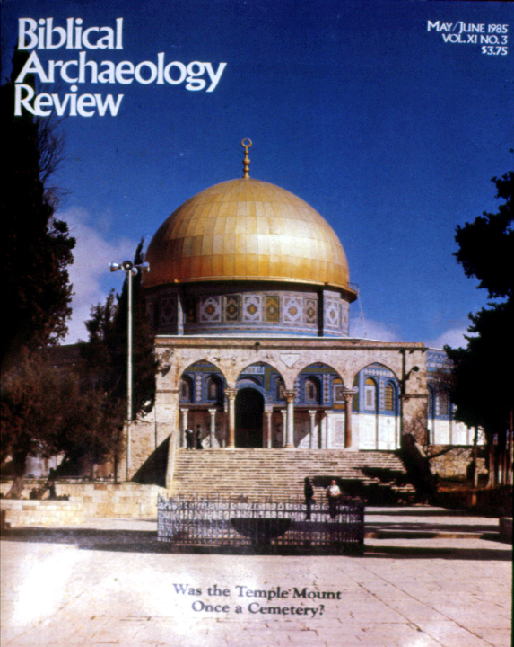

Slide 11
We begin with a picture of King Nabonidas, father of King Belshazzar who lived at the time of Daniel in the Old Testament. We know about Nabonidas because of the thousands of clay tablets that have been excavated by archaeologists, telling of the era of time in which he lived, i.e. the 5th century B.C.

Slide 12
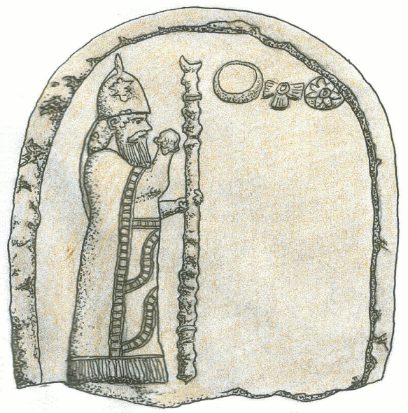
King Nabonidas, father of Belshazzar, 539 B.C.
Drawing by Glenn Scott

Slide 13
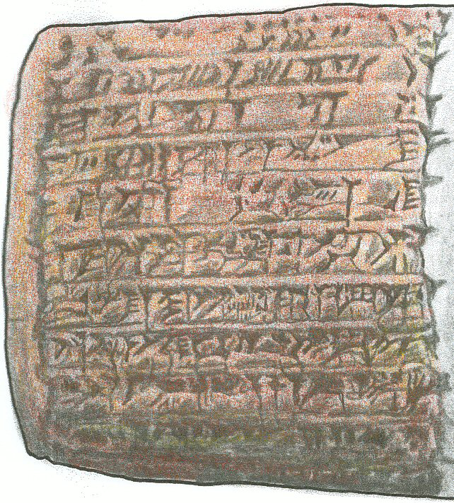
Clay tablet from the time of Daniel and King Nabonidas
Drawing by Glenn Scott

Slide 14
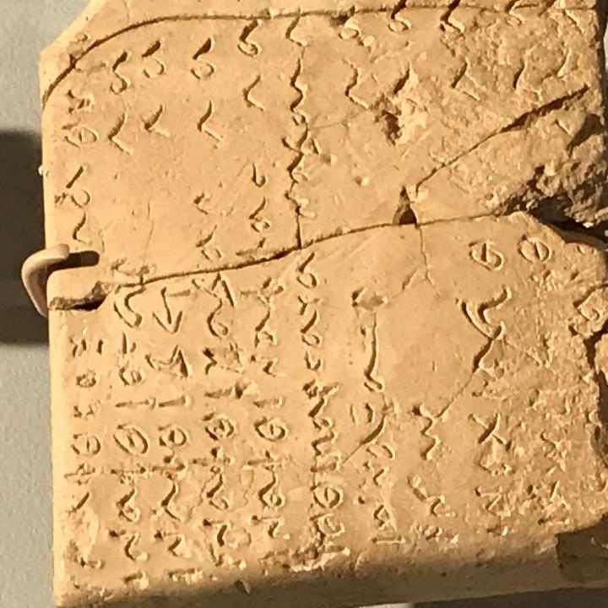
Notes:
Semitic Museum, Harvard University Campus

Slide 15
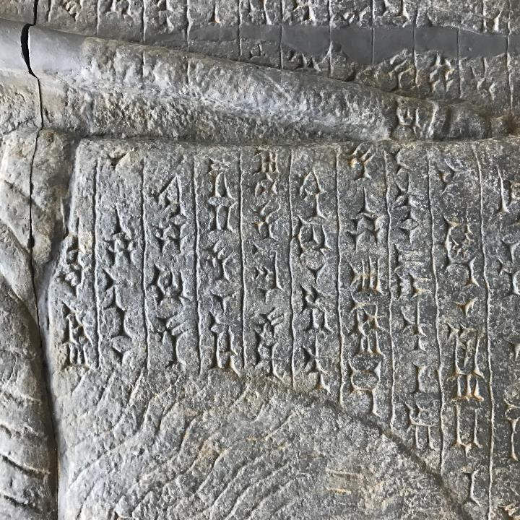

Slide 16
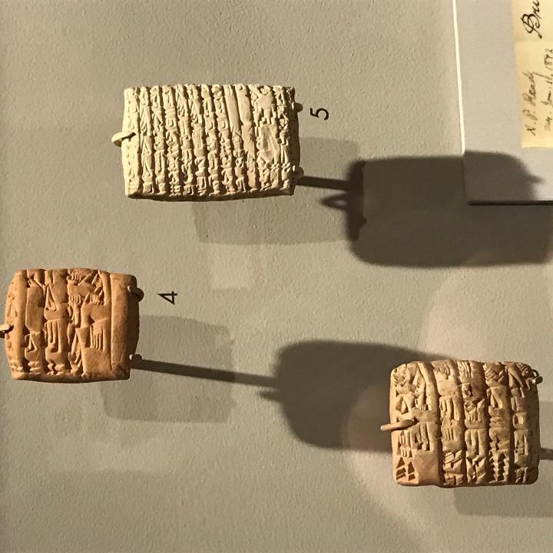

Slide 17
The articles in BAR, March/April1987, while not directly speaking about The Book of Mormon, offer good evidence that cultural and linguistic narratives in The Book of Mormon preserve correct information about Judah in the 5th and 6th centuries B.C.
continued

Slide 18
It also points out that “archaeological discoveries like these (the finding and translation of the clay tablets) cannot, of course, prove that the narratives in Daniel (in the Bible) report events that actually occurred in the 6th century B.C. continued

Slide 19
continued
but they, and other finds like them, do indicate that those narratives preserve correct information about Babylon at the time they were supposed to have occurred.”
Biblical Archaeology Review (May/June 1985): 78

Slide 20
This concept is of major importance to understanding the role of archaeological evidence and how it relates to The Book of Mormon.
By understanding this kind of archaeological evidence we know to look at narratives in The Book of Mormon and see if they preserve correct information about Israel in the 5th and 6th centuries B.C., during the time of Lehi.

Slide 21
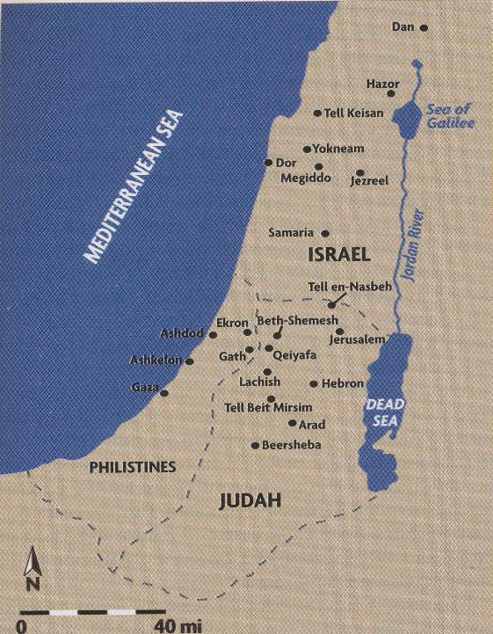
First we take you to Arad, a site south of Jerusalem.
Later we will go to Jerusalem.

Slide 22
“The Israelite fortress at Arad is unique in the land of Israel. It’s the only site excavated with modern archaeological methods that contains a continual archaeological record from the period of the Judges (ca.1200 B.C.) to the Babylonian destruction of the First Temple (586 B.C.).”
Biblical Archaeology Review (March/April 1987): 17

Slide 23
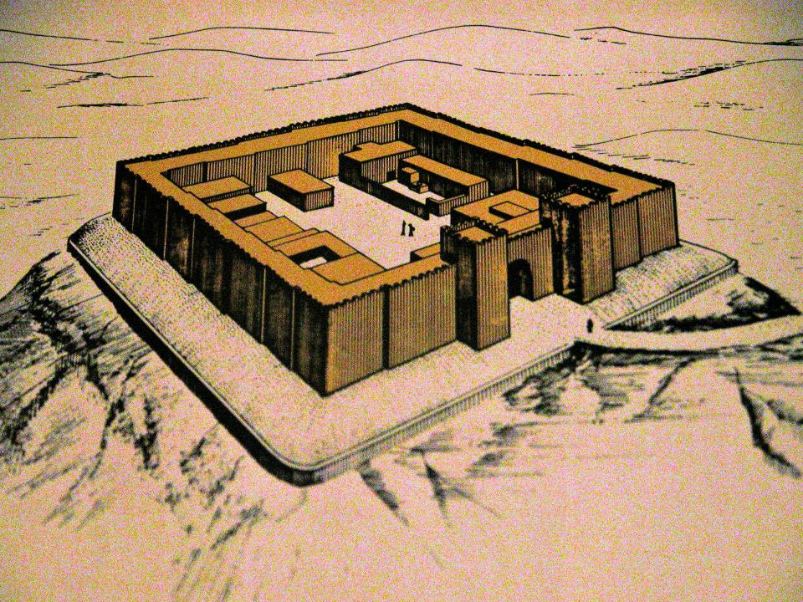

Slide 24
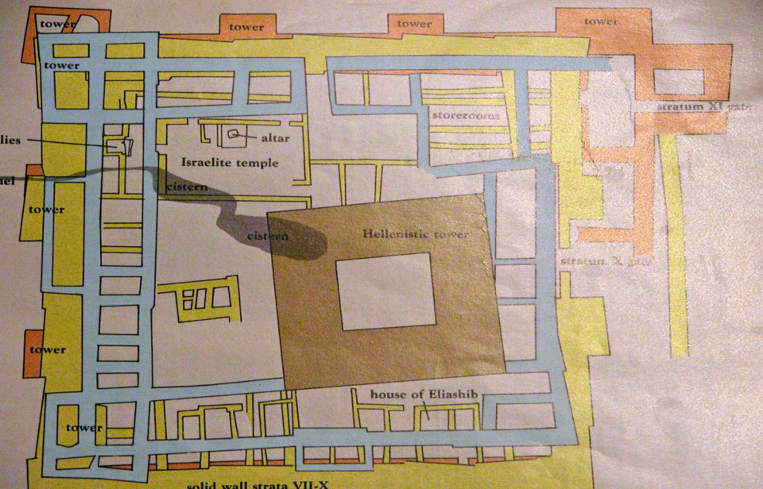
Color coded floor plans of the different times of occupation of the fortress
Notes:
Floor plans of the different times of occupation of the fortress.
Red/brown, time of Solomon
Yellow, 7th to 9th centuries BC
Blue, early 6th century BC
Brown, 2nd and 3rd century BC

Slide 25
Arad is on the edge of the desert. Except for the fort and the hilltop there is not much to see.

Slide 26
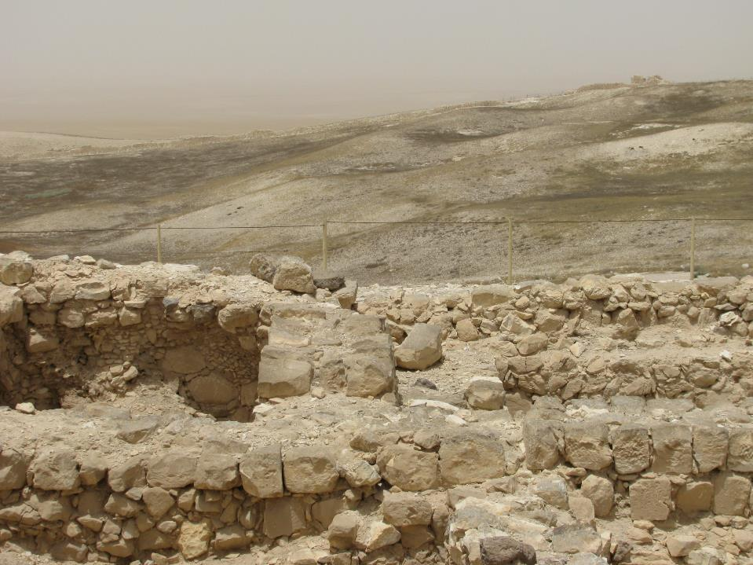

Slide 27
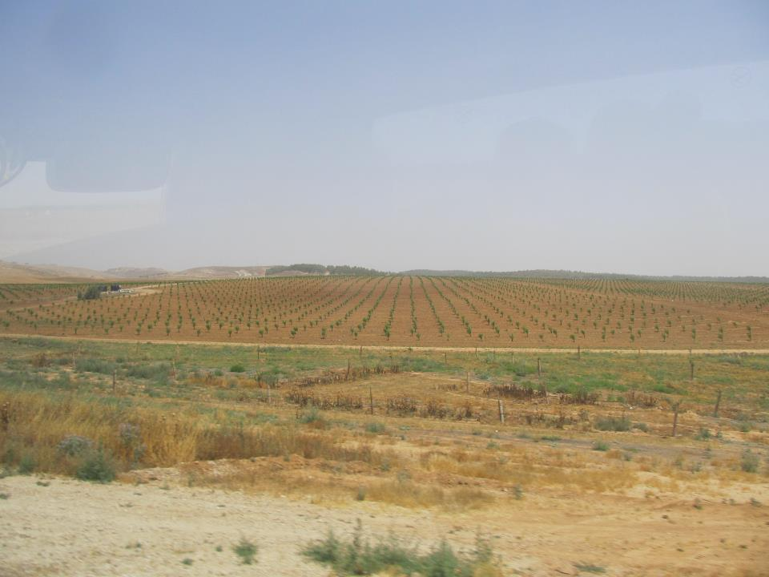
Notes:
If one looks the other way from the fort you see this. Israel is turning their tiny country into fulling the scripture that it would blossom as a rose. They are doing so by using drip irrigation, using water from the Mediterrian Sea. It is not desalinazed enough to drink, but can be used for irrigation of plants, in this case coconut trees.

Slide 28
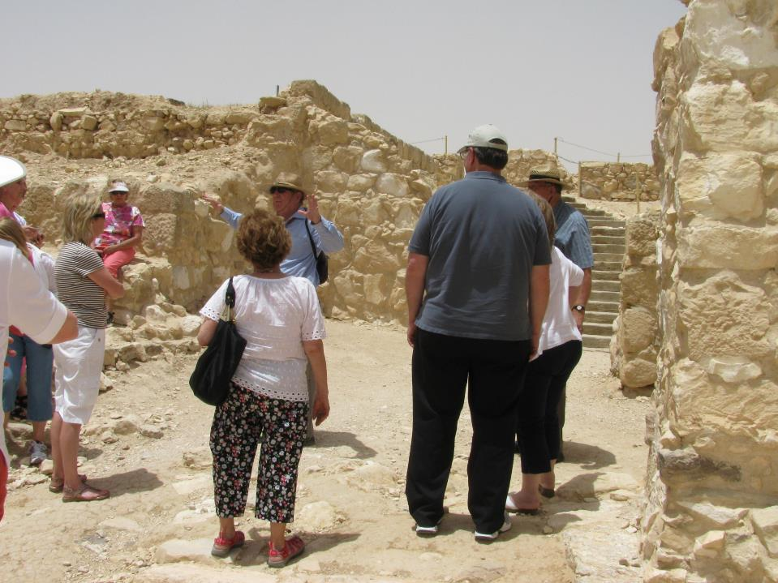

Slide 29
This was an unusual dig in that the archaeologists measured the site by square meter and one meter at a time they dug the whole top of the hilltop including the fortress, down to bedrock. They found everything that was left and was able to catalog and describe it. They also found many pieces of pottery, some with writing on it.

Slide 30
“Over 80 other Hebrew inscriptions were found at Arad because of the special care to insure that none was overlooked. Moreover, unlike the rare collections of inscriptions found at other sites in Israel, the Arad inscriptions range over a period of 350 years, covering six different strata. As a result we can study the develoment
        Continued:

Slide 31
Continued:
of cursive Hebrew script—so called old Hebrew (as opposed to the later square Hebrew script)—from the United Monarchy, say about 950 B.C. to the Babylonian conquest of Judah in the early 6th century B.C.”
“The Saga of Eliashib.” Biblical Archaeology Review March/April 1987): 36, 37

Slide 32
“The Eliashib letters and other inscriptions discovered at Arad now comprise the most valuable corpus of ancient Hebrew inscriptions from the period of the Israelite monarchies.”
      Biblical Archaeology Review (March/April 1987):, p 39
Notes:
Eliashib was a commander of the fort about the time of Lehi.

Slide 33
There are five points about this dig at Arad that present evidence that The Book of Mormon narratives preserve correct information about Judah at the time it was supposed to have occurred.

Slide 34
Narrative #1
The Book of Mormon
Chapter 1 of 1Nephi tells an interesting story. A military commander named Laban has charge of the Brass Plates which contains a religious record of the Jews.

Slide 35
Because of this story, The Book of Mormon has often been under attack because it says that the Brass Plates were in the possession of Laban, a military commander. After all, the critics said, the military would not keep historical/religious records. And it was further thought that military commanders probably could not even write at 600 BC.

Slide 36
So, when I read the articles in BAR about Arad, the information indicating that military commanders were keeping records at 600 B.C. and before, it caught my attention.
Here is the evidence.

Slide 37
Narrative # 1
Archaeological evidence
Military Commanders Kept Records
“this archive demonstrates that …writing was common at administrative and military centers in Judah and Israel” (at and before 600 B.C.).
Biblical Archaeology Review (March/April 1987): 38

Slide 38
Therefore, the evidence from Arad proves that the narrative in The Book of Mormon, while not talking about Laban specifically, preserves correct information by indicating that military commanders kept written records in Judah at 600 B.C.
Yes, The Book of Mormon is culturally correct in this narrative.

Slide 39
Narrative # 2
The Book of Mormon
2 Nephi, chapter 4 indicates that Nephi built a temple outside Jerusalem shortly after arriving in the Promised Land. Until this dig at Arad, we had no archaeological evidence, (and only Book of Mormon supporters believed), that the Jews built temples outside of Jerusalem in this era, ie. that were before 600 B.C..
Before looking at the evidence, let’s look at Jerusalem and then a replica of the temple in Jerusalem.

Slide 40
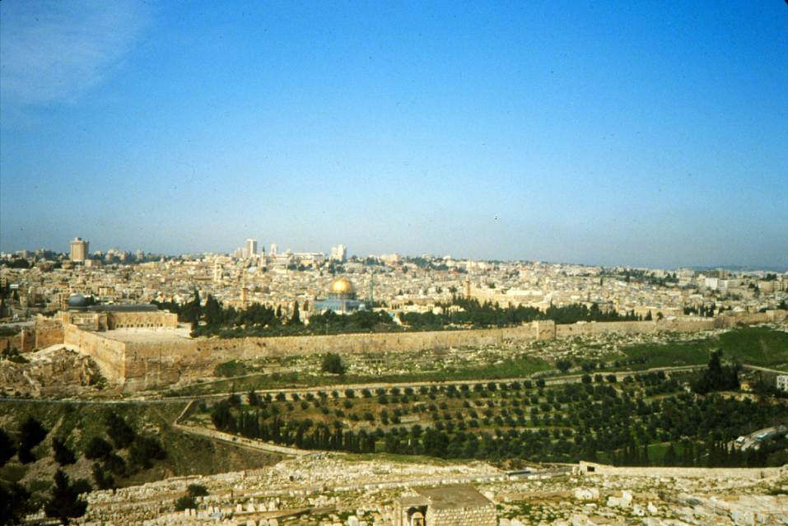
Today the Dome of the Rock sits on the Temple Mount.
Notes:
Here we show southern and eastern walls of the Temple Mount. Today the Dome of the Rock sits on the Temple Mount.
Of course the temple Solomon built was destroyed by the Babylonians shortly after Lehi left Jerusalem. You know the history how after being destroyed the Jews were able to return from Babylon and rebuild the temple. That temple was there until the time of Christ. It was destroyed at AD 70 when the Romans destroyed the city. Now, the Mosque, the Dome of the Rock is on the Temple Mount.
BUT today in Jerusalem a replica has been built of the old city of Jerusalem, as it was at the time of Christ.
the

Slide 41
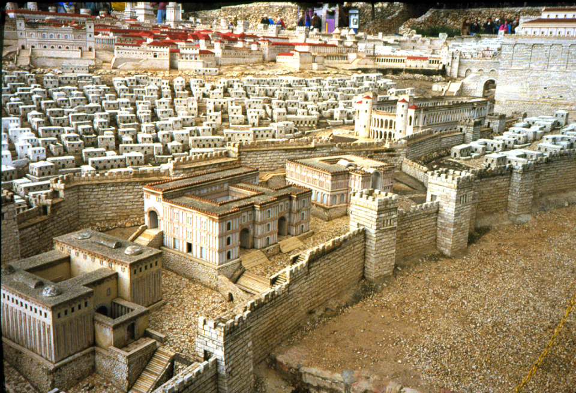
In the replica the buildings are about two feet high.
Notes:
Here we have a mockup of the old city of Jerusalem. One man spent most of his life building this replica of the old city. The buildings are about two feet tall. Notice that his research shows that Jerusalem had two walls around the city at the time of Christ. We can see a small part of the temple mount in the right upper part of the picture.

Slide 42
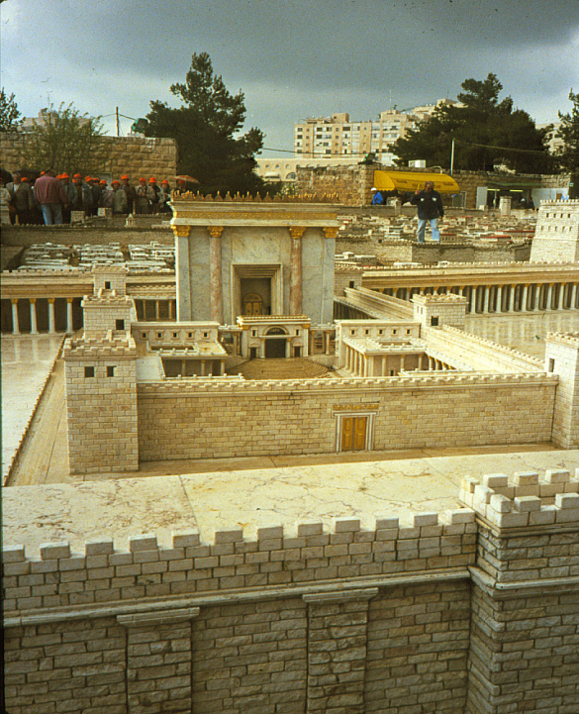
This is a picture of the model city that shows what the temple might have looked like. The Old Testament has a lot of information about the temple.
Notes:
But now lets look at the article from BAR about the discovery of a temple built outside Jerusalem.

Slide 43
Narrative # 2
Archaeological evidence
Unexpected Temple Unearthed
“A unique Israelite temple dedicated to Yahweh—the only temple dedicated to the Hebrew God, ever found in an archaeological excavation.”
Biblical Archaeology Review (March/April 1987): 28
Notes:
This was the first temple found by archaeologists outside Jerusalem built before the time of Lehi. Since this dig other temples have been found outside Jerusalem that predate Lehi.

Slide 44

Notes:
Lets look at a floor plan of the different times of occupation of the fortress.
Red/brown, time of Solomon Yellow, 7th to 9th centuries BC Blue, early 6th century BC Brown, 2nd and 3rd century BC
Point out the temple area in the fort.

Slide 45
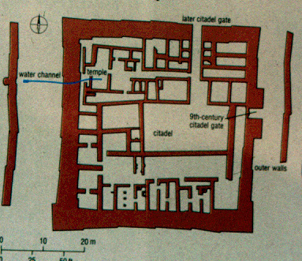

Slide 46
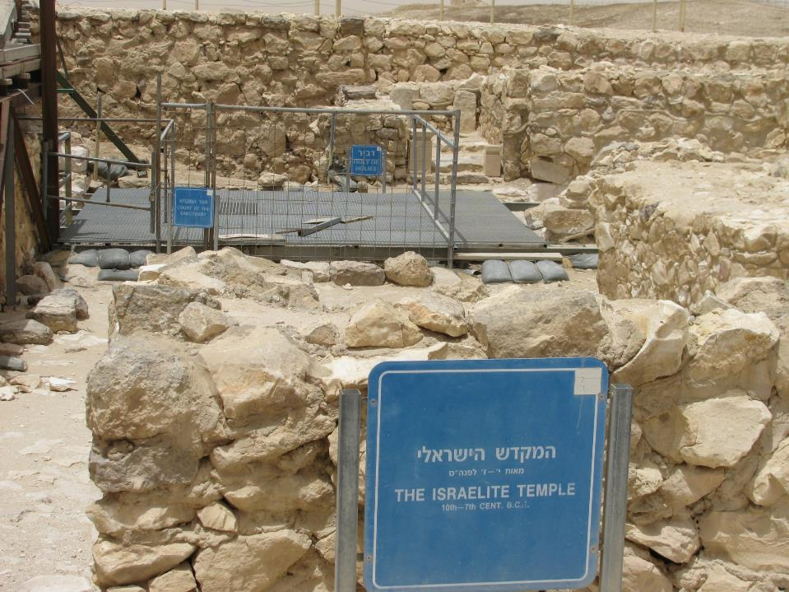

Slide 47
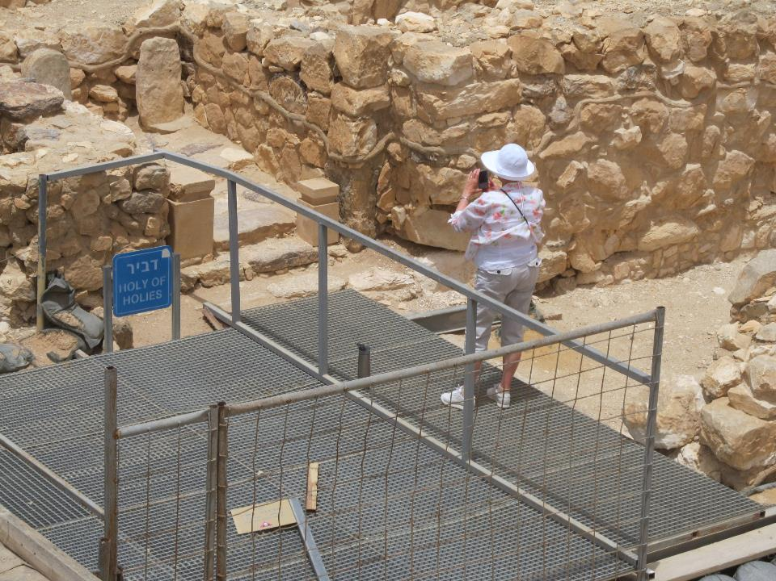

Slide 48
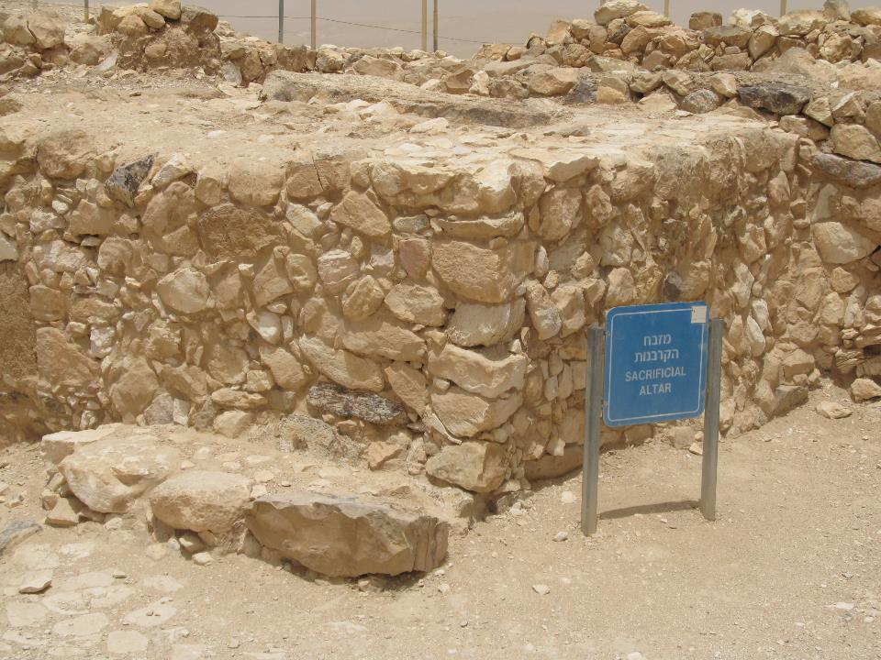

Slide 49
Once again we see that The Book of Mormon preserves correct information about Judah at the time it was supposed to have occurred, in that the Jews had built at least one temple outside Jerusalem at and before the time of Lehi.
Notes:
So when Nephi built a temple in the Promised Land he was doing what other Jews of his time did in Israel.

Slide 50
Do we have any evidence in Mesoamerica, in the area we believe Book of Mormon people lived, to support such a view?
One way is to compare floor plans of Solomon’s Temple with temples in Mesoamerica.
Notes:
But before we compare floor plans I need to remind you where Mesoamerica is.

Slide 51
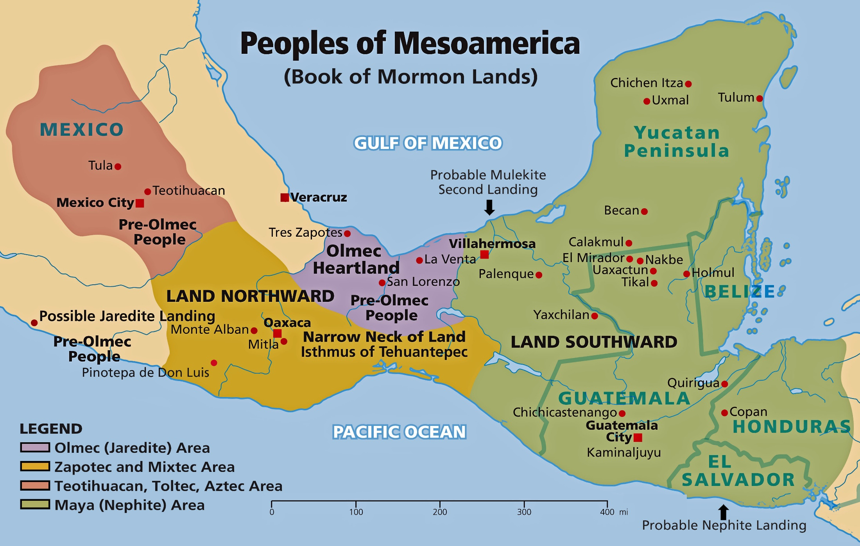

Slide 52
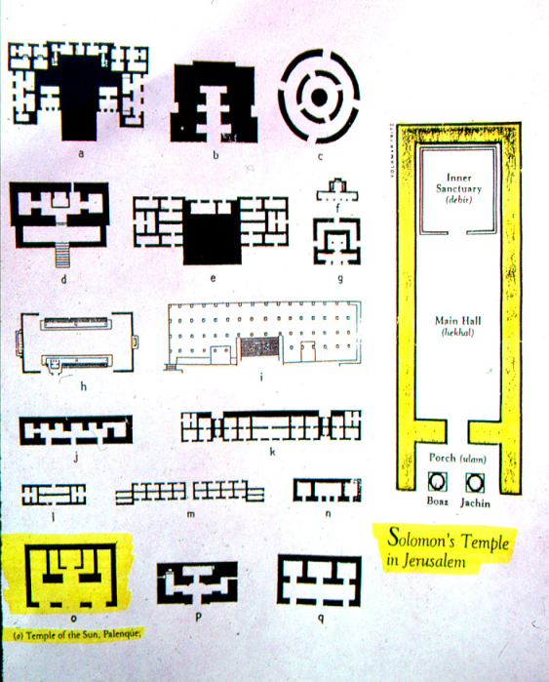
Left side: Temple floor plans in Mesoamerica
Right side:
Solomon’s Temple in Jerusalem
Notes:
Now lets see drawings of temple floor plans in Mesoamerica. We show you sixteen floor plans of temples built there. After seeing them note that the drawing on the right is a drawing of the floor plan of Solomon's temple. I also point out to you the floor plan of the temple of the sun at Palenque, one of the cities in Mesoamerica. It is color coded in yellow also. The two floor plans have essentially the same features, even though Solomon’s Temple is much longer and larger.

Slide 53
The Temple of the Sun at Palenque in Mexico was built in A.D. 692, many years after Nephi built the temple in The Book of Mormon. (See 2 Nephi 4:22).
What it does show is a remarkable resemblance to the floor plan of Solomon’s Temple.

Slide 54
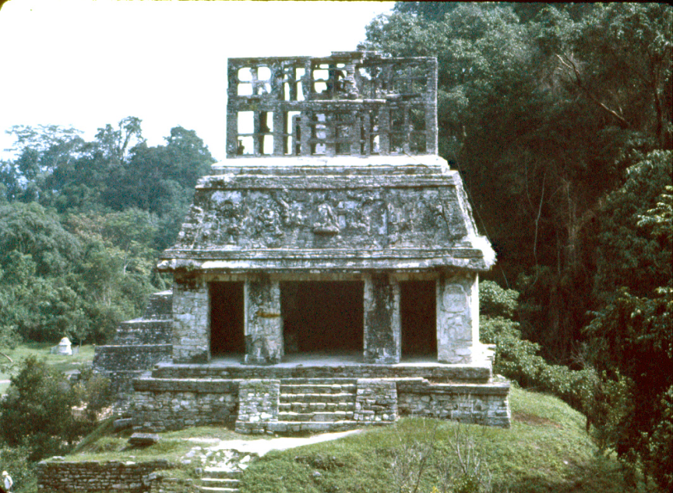
Temple of the Sun, Palenque

Slide 55

Left side: Temples in Mesoamerica
Right side:
Solomon’s Temple in Jerusalem

Slide 56
Narrative # 3
The Book of Mormon
Hebrew records written in Egyptian
“…which consists of the learning of the Jews and the language of the Egyptians.”
1 Nephi 1:1

Slide 57
Nephi’s statement, that he wrote on the plates in Egyptian, has long been doubted by critics of The Book of Mormon. They have not believed that Hebrew records would have been written in another language. It’s like writing the history of the United States in French.

Slide 58
Narrative # 3
Archaeological evidence
Hebrew Speaking Scribe Writes Records In Egyptian
“An ostracon was found written entirely in Egyptian hieratic (cursive) script … [It] was written by a Hebrew-speaking scribe.”
Biblical Archaeology Review (March/April 1987): 37
Notes:
An ostracon is a piece of pottery with writing on it.

Slide 59
“Indeed, Egyptian symbols for numerals and measures, as well as for commodities, are found in Hebrew inscriptions, not only from the southern kingdom of Judah but even from the northern kingdom of Israel.”
Biblical Archaeology Review (March/April 1987): 37

Slide 60
For the third time, the evidence at Arad indicates that The Book of Mormon presents information that is correct for the early 5th century B.C., the time it was supposed to have occurred. Record keeping was done in Egyptian, not just in Hebrew. Hebrew scribes were writing important documents in Egyptian.
Notes:
The findings at Arad helped clarify that Nephi, when he made his record in Egyptian, was doing what other Hebrew writers of his time did.

Slide 61
Narrative #4
The Book of Mormon
The name Mulek identified as
the son of a king.
“Now the land south was called Lehi, and the land north was called Mulek, which was after the son of Zedekiah, for the Lord did bring Mulek into the land north, and Lehi into the land south.”
Book of Helaman 2:129

Slide 62
Narrative # 4
Archaeological evidence
L’Melek (Belonging to the King)
“[A] most interesting sherd …one of a type archaeologists call L’Melek handles because they all bear an inscription saying L’Melek (belonging to the king) of some place….The handles are known to date to the 8th century B.C.”
Biblical Archaeology Review (March/April 1987): 42
( A sherd is a piece of pottery with writing on it.)
Notes:
Explain sherd

Slide 63
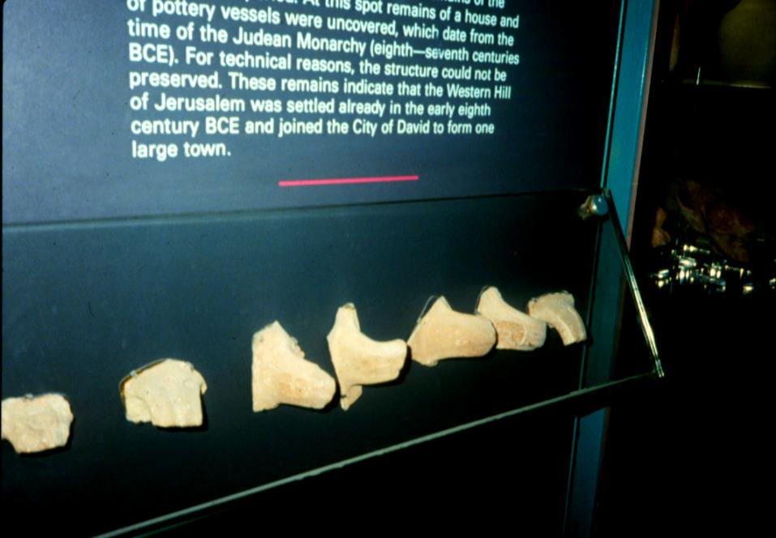
Jar handles imprinted with MLK, belonging to the King

Slide 64
It’s like our government offices today. Each item of equipment has a stamp on it indicating “PROPERTY OF THE UNITED STATES GOVERNMENT.”

Slide 65
At the time of Lehi, written Hebrew did not include vowels. Therefore, leaving out the vowels, the name L’Melek could also be L’MLK, MULEK being the name of King Zedekiah’s son.
These jar handles with the seal of L’MLK, which means “belonging to the King or the Son of a King,” show that L’MULEK is a title, not a given name.

Slide 66
Also in the March/April 1999, p 41, issue of Biblical Archaeology Review, the article “King Hezekiah’s Seal Bears Phoenician Imagery” tells of an archaeological artifact, a seal, that uses the term MLK. It reads, “Belonging to Hezekiah, (son of) “Ahaz, King of Judah.”

Slide 67
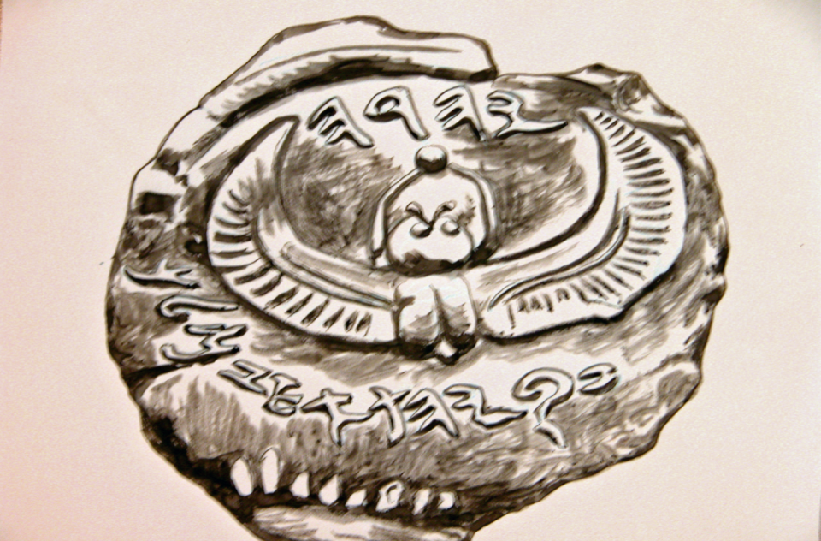
Clay seal belonging to Hezekiah son of Ahaz
Drawing by Glenn Scott

Slide 68
For the fifth time The Book of Mormon contains information that is correct for the time it occurred, as in Mulek (son of the king).
Also, the name Mulek holds special interest for us as a calendar day name in Mesoamerica. There are many examples of this hieroglyph in the Maya area.

Slide 69
Narrative # 5
The Book of Mormon
The standard opening of “and now”.
Before we look at what The Book of Mormon says, we are going to look at the archaeology first.

Slide 70
Narrative # 5
Archaeological evidence
In BAR, March/April 1987, pages 36-39, Anson F. Rainey writes about the office files of the commander of the fort. In the translation of some of these files, Rainey indicates that “and now” is a “standard opening.”

Slide 71
“To Eliashib, and now (the standard opening), give the Kittiyim (50 solders) three baths (barrels) of wine and write the name of the day.”
“To my lord Eliashib, May Yahweh seek your welfare.
And now . . . as to the matter which you commanded me….”
Notes:
Explain Kittiyim and bath

Slide 72
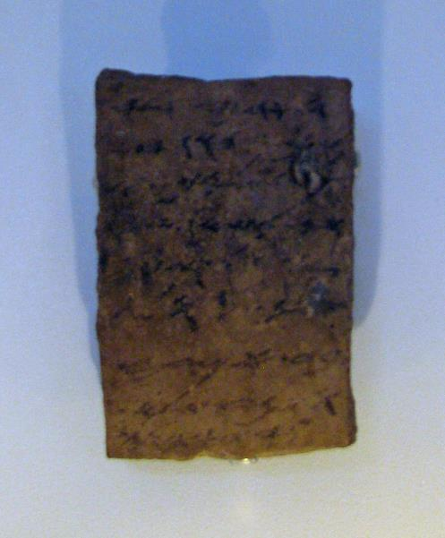
A letter written in ink on pottery, early 6th century from Arad.
“To my lord Eliashib . . . And now: Give to Shemaryahu….”
Notes:
Photo of the piece of clay with writing on it is on display in the Israeli Museum in Jerusalem.

Slide 73
Professor Rainey calls “And now” a standard opening. It must be like “Dear Sir” in our present-day letters. To be considered a standard opening means it was used often in the writing of that era.

Slide 74
This caught my attention because I know that The Book of Mormon uses the phrase “it came to pass” in much the same way, like a standard opening. So, I wanted to see if “and now” is used as a standard opening in The Book of Mormon.
Notes:
DON’T CHANGE SLIDE---MAKE THEM LOOK IT UP>

Slide 75
“AND NOW”
Beginning Words of 1 Nephi
Chapter
1. I, Nephi, having been born
2. And now I, Nephi, do not give
3. And now I, Nephi, proceed
4. And it came to pass
5. And now it came to pass
6. Now it came to pass
Notes:
OK what about 2nd Nephi?

Slide 76
“AND NOW”
Beginning Words in 2 Nephi
Chapter
And now it came
And now I speak
And now, I, Nephi,
Behold, it came to
The word of Jacob,
And now, my
And now I, Jacob,
And now Jacob
Chapter
In the year
The burden of
Now I, Nephi,
And now, behold
And now I, Nephi,
And now behold,
And now I, Nephi,
Notes:
What about the beginning words of all the chapters in the BoM?

Slide 77
The Book of Mormon
“and now”
as a standard opening
Books “and now” other
    1 Nephi 3 3
    2 Nephi 10 5
    Jacob 2 3
    Enos 0 1
    Jarom 0 1
    Omni 0 1
    Words of Mormon 1 0
    Mosiah 9 4

Slide 78
    Alma 11 19
    Helaman 4 1
    3 Nephi 9 4
    4 Nephi 0 1
    Mormon 3 1
    Ether 5 1
    Moroni 2 8
    “and now” other
    TOTALS 46 44

Slide 79
For the fifth time we see evidence from the dig at Arad that provides proof that The Book of Mormon provides correct cultural and linguistic narrative for the time it was supposed to have occurred.
Now we are leaving the evidence from Arad and going to a set of tombs in Jerusalem.

Slide 80
Narrative # 6
Book of Mormon
“When Joseph Smith Jr. in 1830 announced to the world that The Book of Mormon . . . was translated from ancient metal plates bound with rings, which he found in a stone box near Manchester, New York, he unleashed a firestorm of criticism which has not ceased to this day.
continued

Slide 81
Continued
All of the ‘authorities’ of his day laughed and said that there was no evidence of ancient peoples ever having left inscribed metal records ….”
Scott, Glenn, glyph notes, May/June 2011, p 1
And they were right in 1830. There was no evidence.

Slide 82
But beginning about 100 years ago archaeologists began to find metal plates with writing on them all around the Middle East and the Mediterranean Sea. At least fifty examples of plates, some with writing on them, have been found. But none of these plates had scripture written on them. So, when information about the Ketef Hinnom tombs became available I became interested.

Slide 83
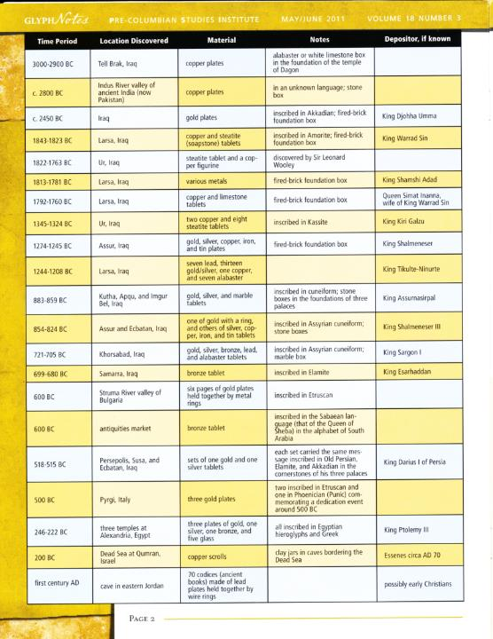
This is a list of some of the metal plates found in the Middle East since 1830. One can view these plates in museums around the world.
Notes:
This is a page out of “glyph notes” our publication. The article was by Glenn Scott in the May/June 2011 issue. Help the audience identify a number of the sets of plates, what they are made of, what years do they date to and where they were the found.

Slide 84
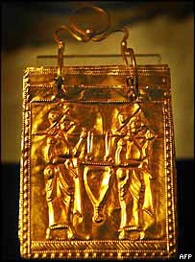
Etruscan gold book with rings

Slide 85
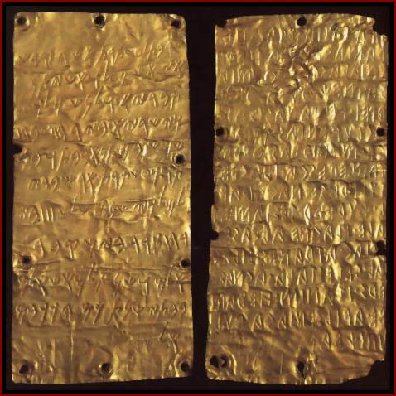
Pyrgi Gold Tablets

Slide 86
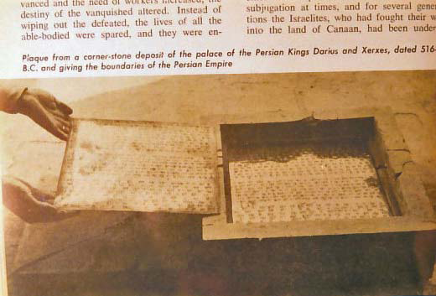

Slide 87
The kind of archaeological evidence about metal plates in the Middle East shows that The Book of Mormon preserves correct information about Israel in the 5th and 6th centuries B.C., during the time of Lehi, in that people in the Middle East were writing on metal plates.
Now, as the topic of metal plates of great importance to us, we will also look at evidence from Mesoamerica.
Notes:
The BoM translated in 1829/30 says that religious records were written on metal plates. In 1830 there was no evidence that this was true, but from archaeological excavations since then we how know that many people kept records on metal plates during the 5th and 6th centuries BC in the Middle East. Therefore the BoM fits the cultural pattern for that time.
Why is this important? We have always had to believe Scripture on faith first. But the Lord wants our faith to turn into knowledge. HE wants our minds to be converted as well as our hearts. Back in the 1950s, 1960 and 1970s cultural evidence from arch was not available. I feel our church leaders began to move out with other ministers in other denominations and found that they would not be accepted if they believed in the BoM. They had no cultural evidence to support it, only their faith.

Slide 89
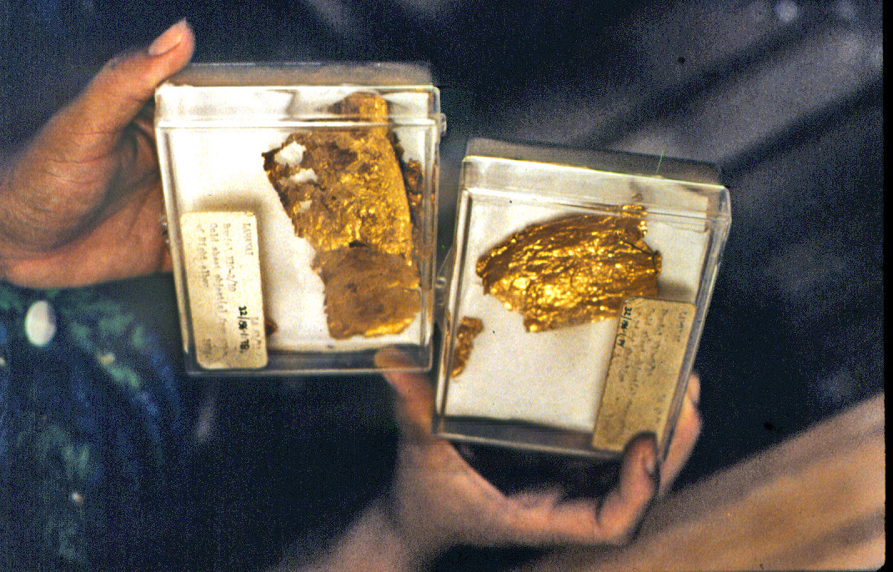
Gold foil from Belize

Slide 90
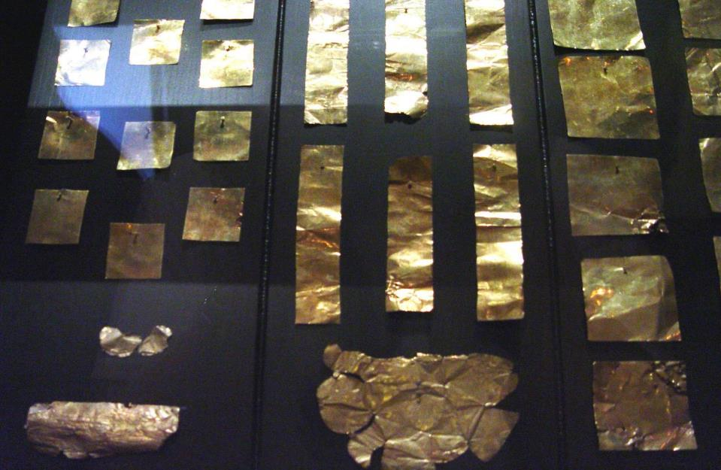
Gold Sheets from Monte Alban

Slide 91
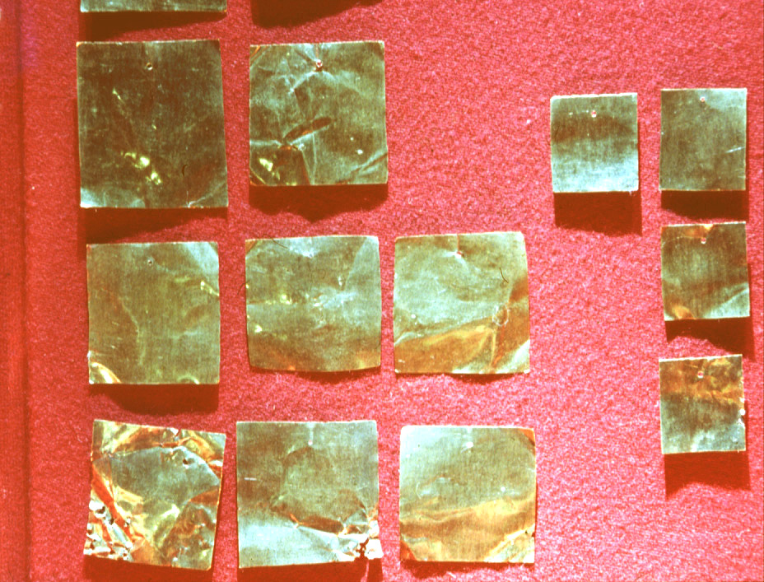

Slide 92
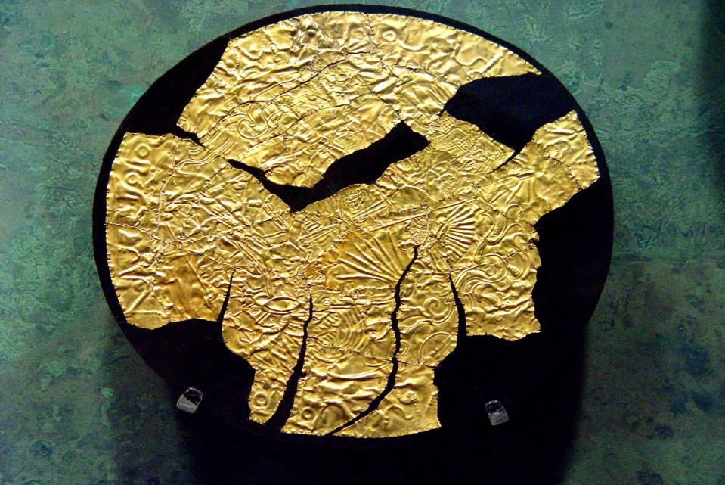
Gold with designs and writing from Chichen Itza
Notes:
I need to tell you that none of the metal plates in Mesoamerica date back to Book of Mormon times. But remember that gold is reusable time after time. Also, that gold was not the most precious commodity in Mesoamerica. The most precious commodity in Mesoamerica was jade. Now we are going back to Jerusalem to a very special set of tombs.

Slide 93
Now we return to Jerusalem. Of all the plates found in the Middle East none have scripture written on them, until now.
The mountains that Jerusalem is built on are all honeycombed with tombs. Many of the tombs are very old, many going back earlier than the time of David and Solomon. Tombs were often reused in later centuries. Today we visit a very special set of tombs called Ketef Hinnom.

Slide 94
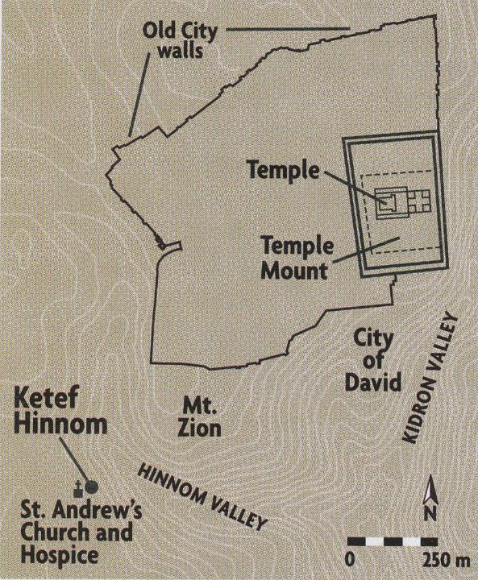

Slide 95
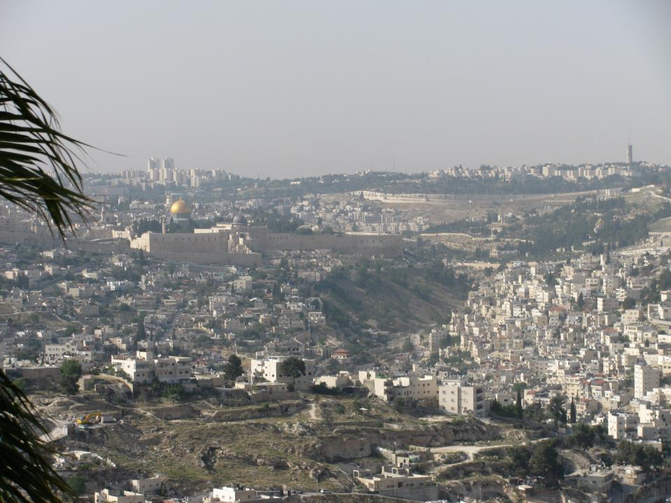
Notes:
This is a current photo of Jerusalem. The deep valley in the right central part of the photo is the Kiddron Valley. On the left of the valley you see the large walls that surround the Temple Mount. Our hotel and guest house St Andrews and the Ketef Hinnem tombs are in the lower left part of the photo.

Slide 96
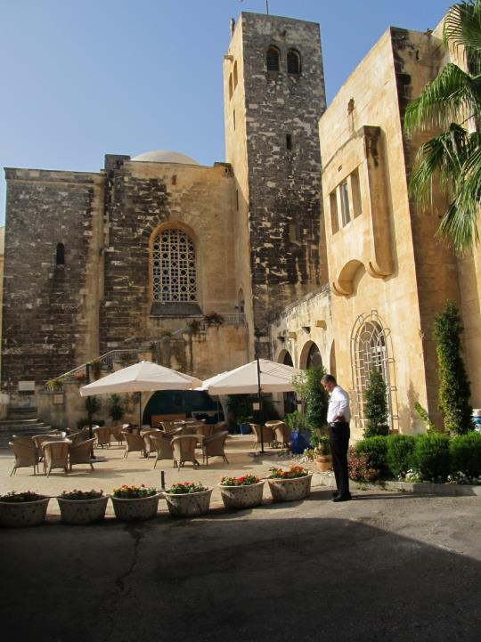
This is St. Andrew’s Scottish Church and Guest House in Jerusalem.

Slide 97
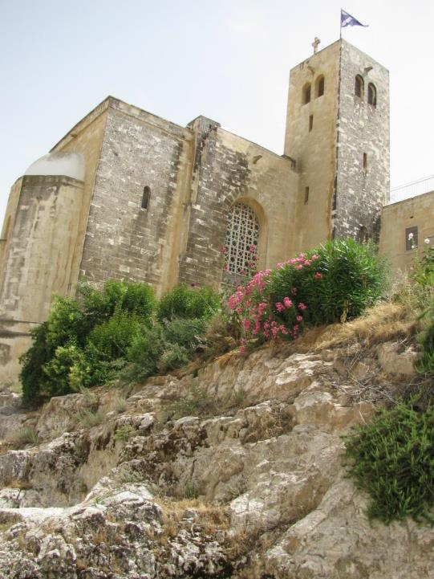
Notes:
The tombs are in the mountain that comes down sharply from where the hotel is. Essentially the tombs are under the church and guest house.

Slide 98
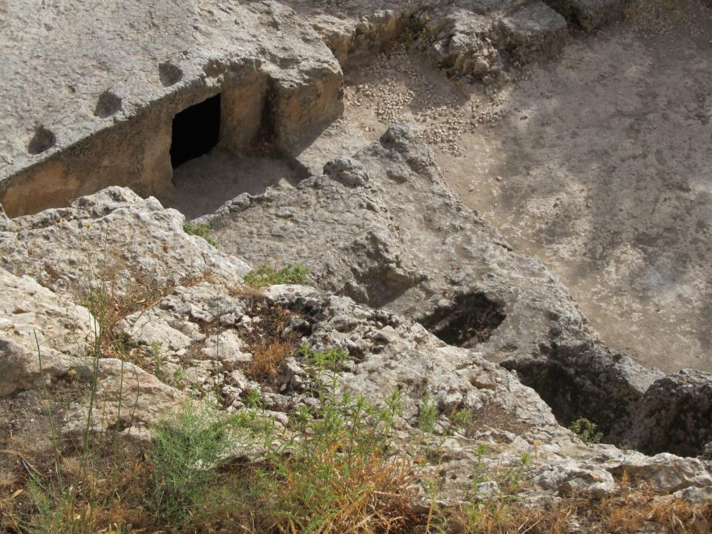
Notes:
When one looks down the mountain from the hotel you can see the entrance to Cave #24 which includes burial chamber# 13.

Slide 99
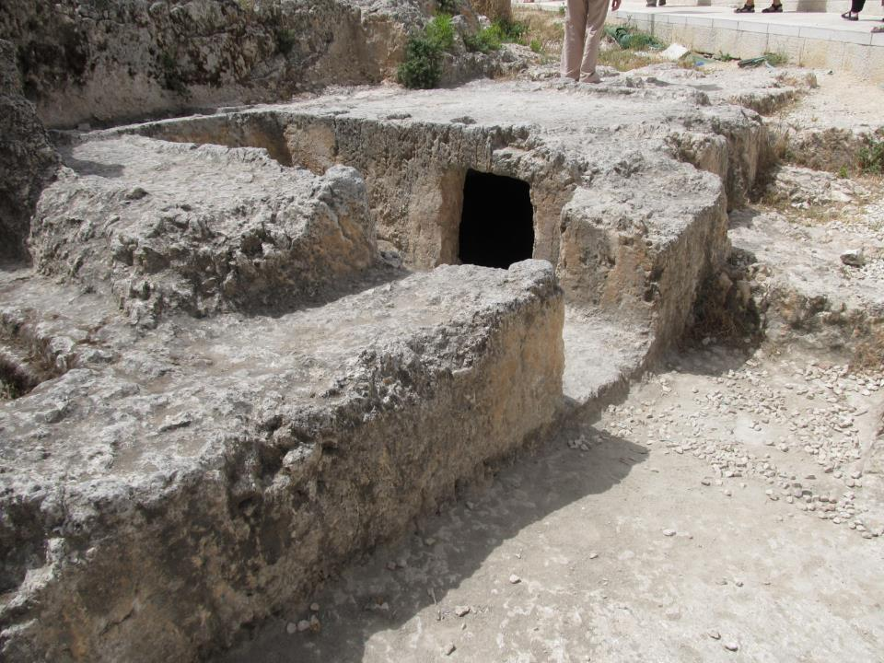

Slide 100
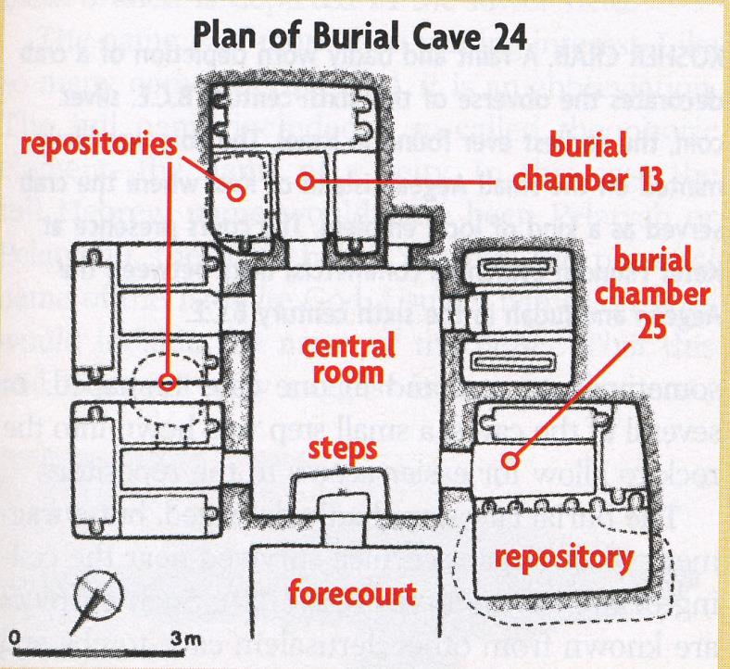

Slide 101
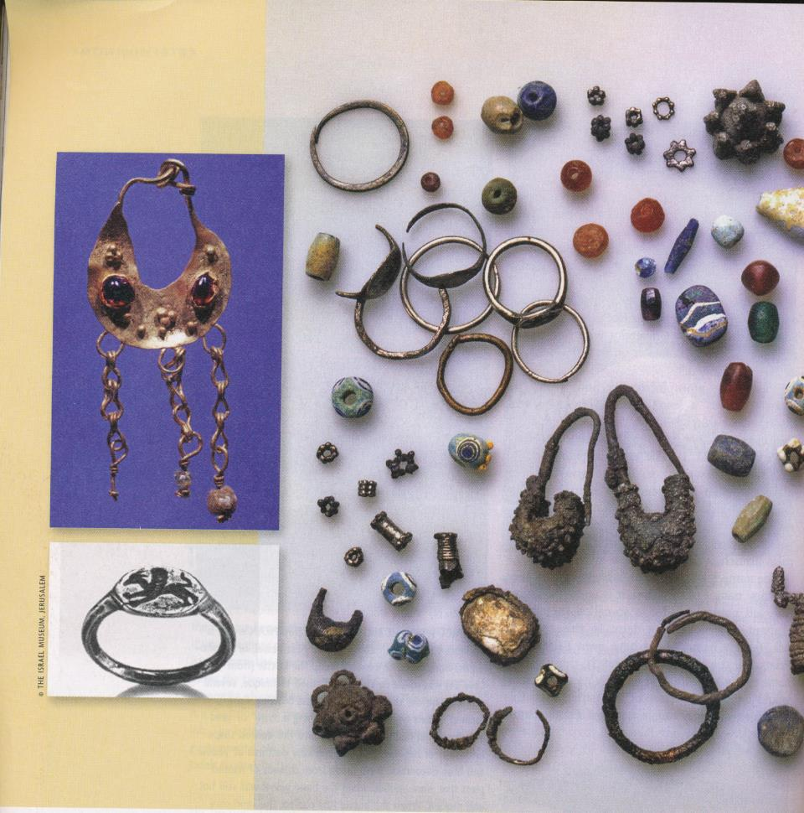
Notes:
This is a photo of a small part of the jewelry found in burial chamber 13. The man was obviously very rich. Along with the jewelry was found two small silver amulets that had engravings on them.
Talk about the riches of Lehi - same era of time.

Slide 102
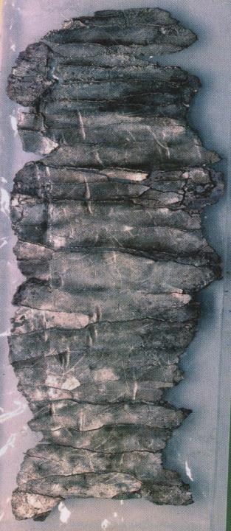
This is one of two small silver amulets found in the Ketef Hinnem tombs in Jerusalem dating from 600 to 700 B.C.

Slide 103
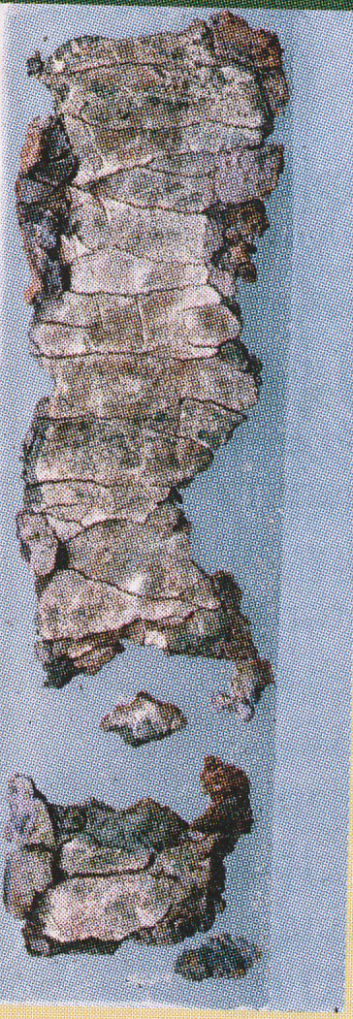
Notes:
Here is a photo of the other small amulet. After considerable research about them it was found that they both had words inscribed on them.

Slide 104
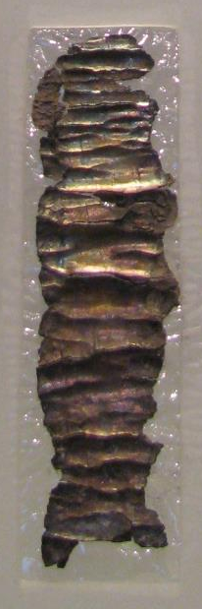
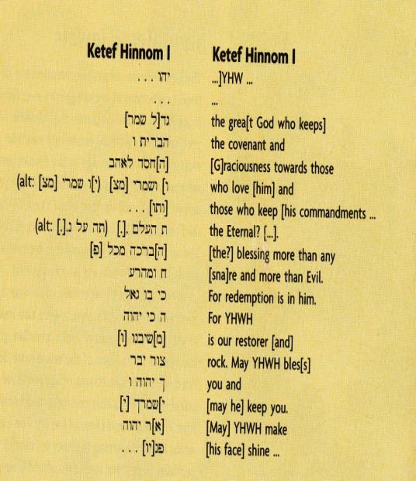
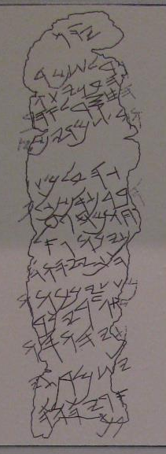
Notes:
Numbers 6:24 the Lord bless thee and keep the; the Lord make his face to shine upon thee, and be gracious unto thee; The Lord lift up his countenance upon thee, and give thee peace.

Slide 105
The discovery of these silver amulets with scripture written on them prove that The Book of Mormon claiming that religious records were written on metal plates at 600 B.C. is an accurate depiction of the culture at the time.

Slide 106
It further proves that at least parts of the Bible were written on metal as early as 600 to 700 BC. Many Bible scholars still contend today that the Bible was only oral tradition until being written down about 200 to 300 B.C.
Then, too, it proves that at least parts of the Bible are remarkably consistent over a 2700 year period. It is trustworthy, especially our Inspired Version

Slide 107
Let’s review the cultural and linguistic evidence.
Military commanders kept written records.
  The narrative about Laban in The Book of Mormon is culturally correct.
An Israelite temple was discovered outside Jerusalem.
  Nephi was doing what others had already done in Israel/Juda in building a temple outside Jerusalem.

Slide 108
Hebrew scribes wrote records in Egyptian.
  When Nephi wrote in Egyptian on the plates, he was doing what others of his time did.
L’ MeLeK (belonging to the king)
  When Joseph Smith used the name “Mulek” in The Book of Mormon he gave a title, not a given name, that means “son of a king.”

Slide 109
“And now” was a standard opening in Hebrew writing in the 5th and 6th centuries BC.
  The Book of Mormon uses “and now” as a standard opening a multitude of times.
The Book of Mormon requires that scripture is written on metal plates before 600 B.C.
Ketef Hinnom tombs reveal scripture inscribed on metal at 600 to 700 B.C.

Slide 110
Consider this question.
How could Joseph Smith have known these six cultural and linguistic traits of the 6th century BC and accurately narrate them in The Book of Mormon?

Slide 111
All of us here are better educated than Joseph Smith was when he translated The Book of Mormon. Also, we have 100 years of modern archaeological evidence that he did not have.

Slide 112
Even with all this archaeological evidence available to us, could you have gotten the answers to these six items from 2600 years ago correct? The answer is “very likely” not.
Notes:
I believe that this provides strong evidence that the book was translated as Joseph said it was, by the power and gift of God.

Slide 113
I choose to believe that it was translated by the “gift and power of God,” because in all the ways that I have studied it, over the past 70 years, I find that it is accurate and true in its theology as well as in its cultural, linguistic and geographical narratives.

Slide 114
And I saw another angel fly in the midst of heaven, having the everlasting gospel to preach unto them that dwell on the earth, to every nation, and kindred, and tongue and people.

Slide 115
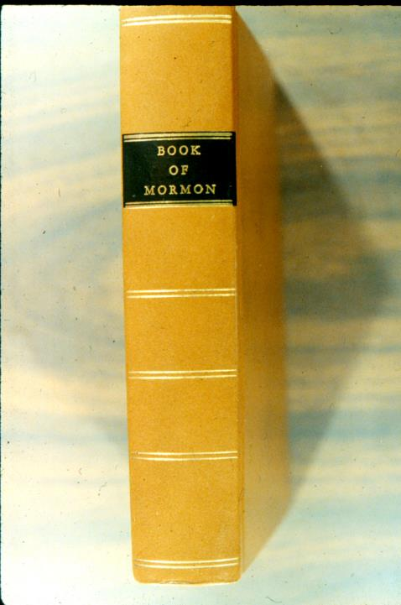

Slide 116
Underlining and coloring of words in this presentation has been done by the authors of this presentation to show emphasis.
This Power Point presentation is available for anyone to use. Please show it using “presenters mode.” That way you will have access to the notes that go with some of the pictures. If you have questions, contact me at smith.lyle@usa.net
Note also that it is under copy write. This means that if you change this material from what we have done you must let your viewers know what you have changed.

