Slide 1
WHERE DO WE FIND
BOOK OF MORMON HISTORY
IN THE NEW WORLD?
JAREDITES

Slide 2

I saw another angel flying
in the midst of heaven having the everlasting gospel to preach
unto them that dwell on the earth

Slide 3
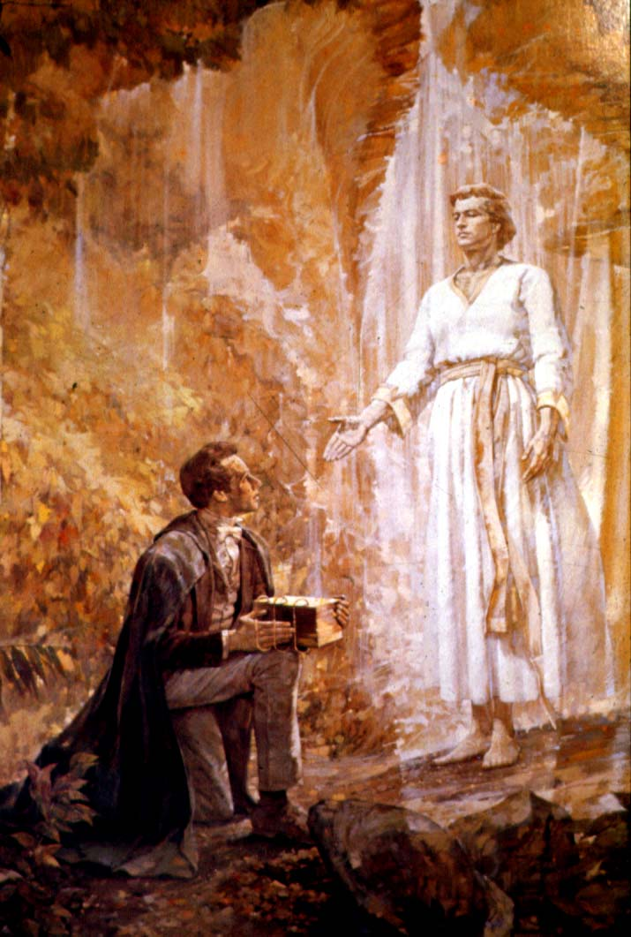

Slide 4
This angel, Moroni, gave Joseph Smith ancient records written in an unknown script, which contained the everlasting gospel. Joseph translated these records, by the power and gift of God, and published them as The Book of Mormon. Could ANYONE in 1830, without God’s help, have written a three-thousand-year history that matches current archaeological evidence of the Olmec and their predecessors in event, date and sequence?

Slide 5
Many believers in The Book of Mormon want to know about the civilizations that once occupied the Americas.
Is there evidence that these pre-Columbian peoples are those found in The Book of Mormon?

Slide 6
In this presentation we are going to look at the Jaredites. We will look at where they came from, their journey, and the probability of when they arrived in the New World.
Then we will look at their civilization in the New World.

Slide 7
After 40 years of research, I have no doubt that only one area of the Americas matches Jaredite history. It is the area the archaeologists identify today as Mesoamerica.

Slide 8
Let’s look at the people of the Brother of Jared. They migrated from Sumer, the worlds earliest recognized civilization, which was the place of the “great tower.” Today we know it as modern Iraq.
Without doubt this journey from the Middle East to the “great sea which divideth the lands” took many years. They were walking, they had to build barges and they had to stop and grow crops for food.
Ether, Chapter 1 through Chapter 3 verse 13)

Slide 9
I believe it reasonable that it took 50 to 100 years for the journey. From the Middle East to the Pacific Ocean is a long, long way on foot.
The Brother of Jared says, “and for this many years we have been in the wilderness…” (Ether 1:64).

Slide 10
Having arrived at the “great sea which divideth the lands”. Ether 1:36
“And thus they were driven forth, three hundred and forty and four days upon the water; and they did land upon the shore of the promised land.” Ether 3:12
Today we know that items float from the coast of Asia to the coast of California or Mexico in about a year.

Slide 11
This would indicate that they came over the Pacific Ocean. The Book of Mormon indicates they floated for 344 days to reach the promised land. To float the Atlantic would have taken much less time.

Slide 12
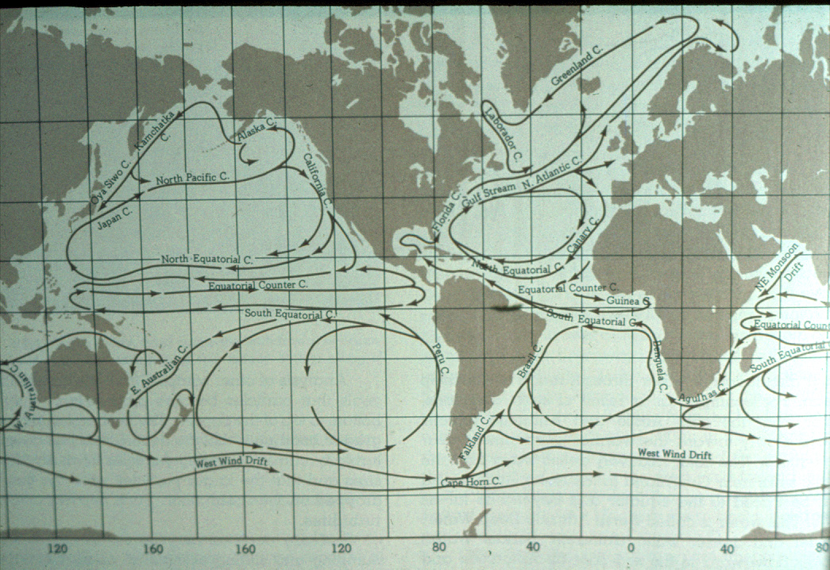
Notes:
Relate Don Montel’s testimony.

Slide 13
The religious record of the Jaredites, however, found in The Book of Mormon only relates to the area of Mesoamerica. In other words, it is not a history for North or South America.
We equate the Jaredites with the people the archaeologists call the pre-Olmec and the Olmec found in Mesoamerica.

Slide 14
Why do archaeologists tell us about the pre-Olmec and the Olmec ? They do so because they only recognize the Olmecs as beginning about 2000 B.C. They document that there were people in Mesoamerica earlier than 2,000 B.C. as pottery and domesticated crops have been found about 3000 B.C. But since the pre-Olmec lived so long ago, little archaeological evidence has been found, but enough evidence, I feel, to equate them as the early Jaredites.

Slide 15
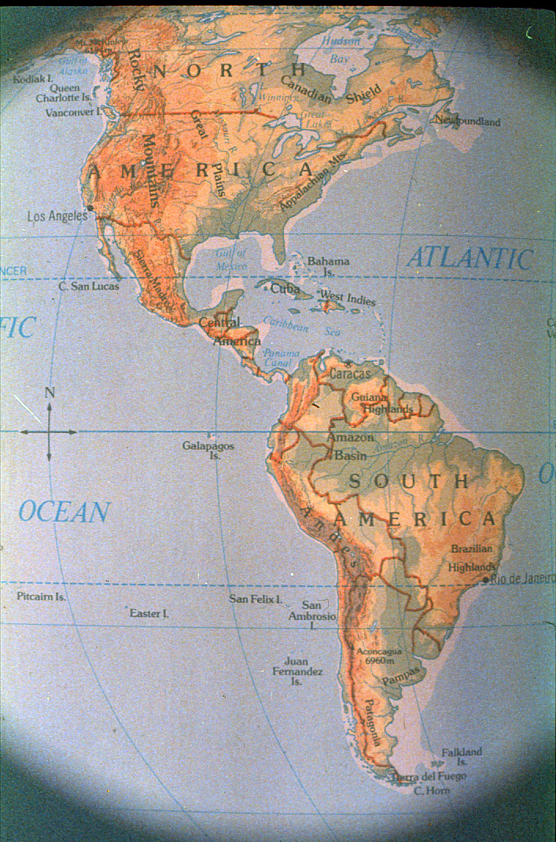
Why the Olmec and their predecessors? The Olmec culture is only recognized by archaeologists as beginning about 2000 years before Christ. People were in Mesoamerica earlier than that as pottery and domesticated crops have been found as early as 3000B.C. But since it is so far back in time there is not much archaeological evidence from this earlier time. Using the current archaeology findings it is probable that the civilization that develops after the “great drought” in Book Mormon history, is the civilization that archaeologists recognize as the Olmec.

Slide 16
“At the time the Lord confounded the language of the people, and swear in his wrath that they should be scattered upon all the face of the earth; and according to the word of the Lord the people were scattered.” Ether 1:7

Slide 17
It should be noted that at the time of Columbus, some 5,000 years after the Jaredite arrival, diverse groups of Native Americans lived in the Americas.
Probably most of them from Jaredite heritage because the Jaredites were here at least 3,000 years. The Book of Mormon is not a history of those that left Mesoamerica.

Slide 18
As the people were scattered upon all the face of the earth, it is quite probable that the Lord could have led other groups to the promised land who are not a part of Book of Mormon history.
A good example could be the ancient cultures in Peru. Many of the Native Americans today may well be descendants of these other probable migrations.

Slide 19
The Jaredite civilization in the Promised Land covers at least 3000 years. It, therefore, also seems reasonable that during that span of time some of the people spread out to North and South America.
If they left Mesoamerica their history was then lost, not being a part of the book of Ether, in The Book of Mormon.

Slide 20
By using the current archaeological evidence, it is probable that the civilization that developed after the “great draught” in Book of Mormon history is the civilization archaeologists recognize as the Olmec.
That means the people in Mesoamerica before the time of the great draught in The Book of Mormon are the ones archaeologists call pre-Olmec.

Slide 21
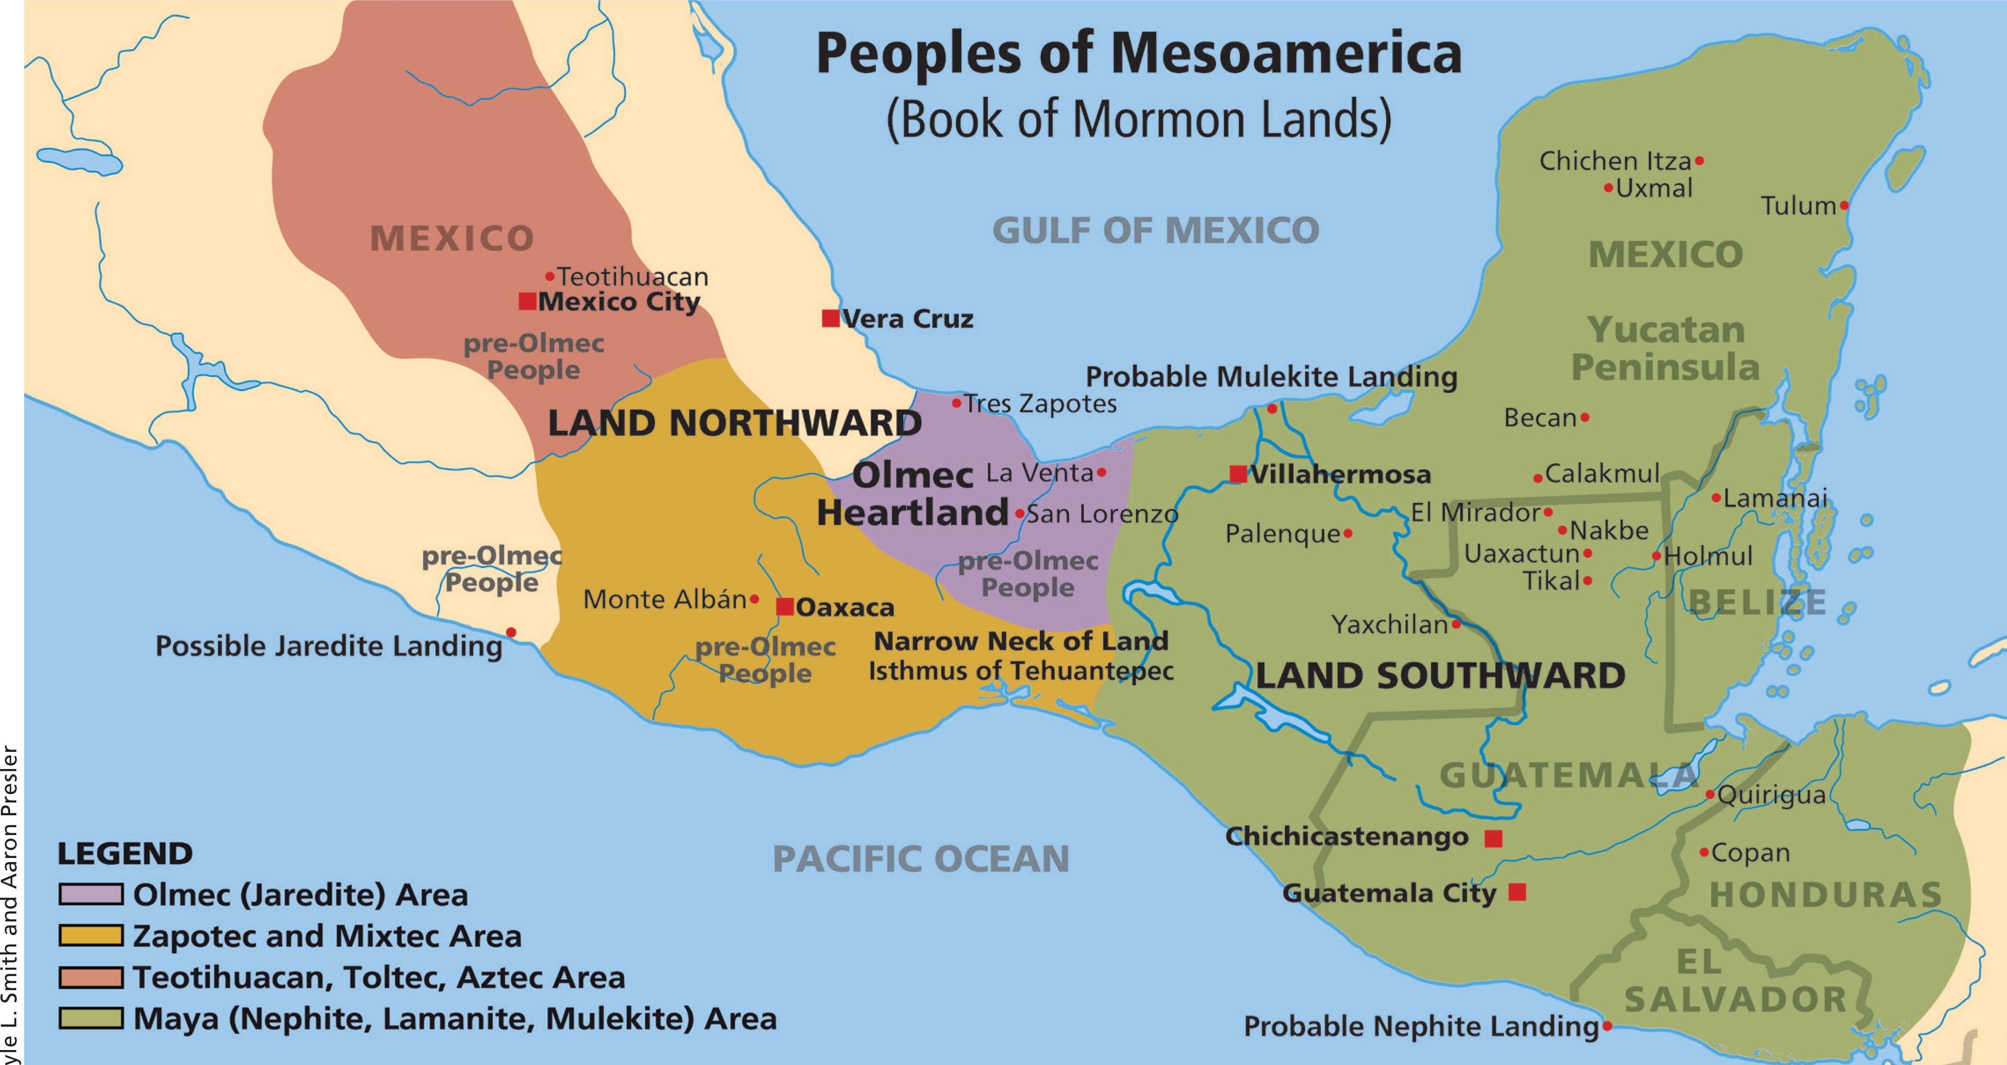

Slide 22
Our method today will be to look at the history of the Jaredites as told in The Book of Mormon. We will compare it with the history of the pre-Olmec and the Olmec told by the archaeologists in current university textbooks.

Slide 23
As we begin to build the Jaredite/Olmec timelines, it is important to know that all Olmec references come from well known archaeologists. These are NOT my theories or ideas. The archaeologists tell the story of the Jaredites even though they do not know it.

Slide 24
Ether records that shortly after the Jaredites came to the Promised Land “they began to spread upon the face of the land, and to multiply and to till the earth, and they did wax strong in the land.” Ether 3:20.

Slide 25
The record in Ether does not specifically mention that the Jaredites had pottery on their arrival. Yet, it says they could till the earth. Having been at the great tower, they in all probability, brought pottery and the knowledge of domesticated crops.

Slide 26
“Archaeological investigations . . . indicate that Olmec civilization had its roots in the early village tradition of both the Pacific and Gulf Coasts.”
Sylvanus Morley, revised by Robert Sharer in The Ancient Maya,1983. Page Number

Slide 27
“By 2500 B.C. (pre-Olmec) farmers at San Andres and their neighbors were living around an estuary bordered by channels of the Grijalva river….”
Richard A. Diehl in The Olmecs: America’s First Civilization, 2004:24.

Slide 29
“ Pottery first appears in Mesoamerica around 2900 BC.”
Richard Adams in Prehistoric Mesoamerica, 1977 NEED Page #
‘’ Lyle L. Smith 2022

Slide 30
“After 3000 B.C., it is clear that lowland societies began to acquire domesticated plants…” as well as some of the earliest, if not the earliest, pottery in Mesoamerica.
Richard Adams, Prehistoric Mesoamerica, 1996, Third Edition, p 42 and see chart on page 36. Notice that the horizonal column for Abejas shows a pottery bowl at 3,000 B.C.

Slide 31
But when do we believe the Jaredites arrived in the promised land?
Based on archaeological evidence in Mesoamerica and Sumer (what is now the ancient civilization found in Iraq), and on the timeline found in The Book of Mormon itself, I propose they arrived 3114 B.C.

Slide 32
Archaeology Timeline
Mesoamerica Book of Mormon
pre-Olmec people 3114 BC Jaredite arrival
Pottery, planted crops 3000 BC Pottery, planted crops
Southwest deserts 2100 BC Great dearth
Over centuries Olmec natio, 1800 BC Over centuries Jaredites
had pharaonic like treasures, highly blessed, great city in
great city in narrow neck narrow neck of land
Land southward not highly 1500 BC Land southward preserved
populated before 600 BC as wilderness
Metals by 1475 BC 1475 BC Metals, Jaredite always had
Writing by 650 BC 650 BC Writing, Jaredites always had
Olmec civilization ceased 300 BC Jaredite civilization ceased

Slide 33
Yet, it was the Maya, not the Olmec, who carved the date, 3114 BC, on a number of stone stelae in several cities. Epigraphers believe this date is the creation date found in Maya beliefs. They call it a “mythical date” because they know Maya cities only showed up about 500 to 600 B.C.
You may ask, “Why is it a Maya creation date when we are talking about the Olmec”?

Slide 34
First, the archaeologists recognize that 3114 BC is not the beginning date for the Maya, hence they call it a “mythical date.”
Second, I feel that since it is carved on stone in several Maya cities, it must be an important date.

Slide 36
Third, the 3114 B.C. date found in the Maya hieroglyphs is the beginning date for their current creation. The past creation date covered from 3114 B.C. to A.D. 2012, about 5,000 thousand years.

Slide 37
Fourth, it makes sense to me that the beginning of ceation in Mesoamerica most probably references the arrival of the Jaredites in the promised land. They could well be the first people in Mesoamerica after the flood.

Slide 38
Fifth, the best archaeological evidence to support this date is that pottery and domesticated crops first appears in Mesoamerica at about 3000 B.C.
We know from archaeology that Sumer had both pottery and domesticated crops before the flood.

Slide 39
Archaeology Timeline
Mesoamerica Book of Mormon
pre-Olmec people 3114 BC Jaredite arrival
Pottery, planted crops 3000 BC Pottery, planted crops
Southwest deserts 2100 BC Great dearth
Over centuries Olmec nation, 1800 BC Over centuries Jaredites have
had pharaonic like treasures, great riches, great city in
great city in narrow neck narrow neck of land
Land southward not highly 1500 BC Land southward preserved
populated before 600 BC as wilderness
Metals by 1475 BC 1475 BC Metals, Jaredite always had
Writing by 650 BC 650 BC Writing, Jaredites always had
Olmec civilization ceased 300 BC Jaredite civilization ceased

Slide 40
Ether records that shortly after the Jaredites arrived in the promised land,
“That they began to spread upon the face of the land, and to multiply and to till the earth, and they did wax strong in the land.” Ether 3:20
Notes:
Pottery is one of the materials that last forever as it is baked dirt,+++

Slide 41
Centuries later, at the time of King Omer, maybe about 2500 B.C., a part of them made a migration eastward, overland, to another sea-shore, east from where they had been earlier. This puts their civilization on two seas. Ether 4:3 and 4
See Glenn Scot’s book Voices from the Dust for a great Jaredite timeline.

Slide 43
According to Glenn Scott’s timeline in his book Voices from the Dust, at the time of King Heth, about 2100 B.C., prophets came into the land again crying repentance. There would be a great famine in the land if the people did not repent.
Notes:
Glenn Scott in his book Voices from the Dust has an excellent timeline of BoM kings and events. He places King Heth at 2165 BC.

Slide 44
“There began to be a great dearth upon the land, and the inhabitants began to be destroyed exceeding fast, because of the dearth, for there was no rain upon the face of the earth….”
Ether 4: 35
Notes:
Even King Heth and his household perished in the famine caused by the great dearth, or lack of rain.

Slide 45
“Geologists have recognized a period of excessively high temperatures which created the deserts of the Southwest. This is known as the Hypsithermal and peaked somewhere between 2000 and 1500 B.C.” Michael Coe in Mexico, 1994:26-27.

Slide 46
Archaeology Timeline
Mesoamerica Book of Mormon
pre-Olmec people 3114 BC Jaredite arrival
Pottery, planted crops 3000 BC Pottery, planted crops
Southwest deserts 2100 BC Great dearth
Over centuries Olmec nation, 1800 BC Over centuries Jaredites
pharaonic like treasures, highly blessed, great city in
great city in narrow neck narrow neck of land
Land southward not highly 1500 BC Land southward preserved
populated before 600 BC as wilderness
Now, metals by 1475 BC 1475 BC Metals, Jaredite always had
Now, writing by 650 BC 650 BC Writing, Jaredites always had
Olmec civilization ceased 300 BC Jaredite civilization ceased

Slide 47
Following the great dearth, it appears that the Jaredites fulfilled the promise of being a great nation. This is when the archaeologists recognize the Olmec, beginning about 2000 B.C.
“And there will I bless thee and thy seed, and raise up unto me of thy seed, and of the seed of thy brother, and they who shall go with thee, a great nation….” Ether 1:19 & 20

Slide 48
“And it came to pass that Coriantum did walk in the steps of his father, and did build many might cities, and did administer that which was good unto his people, in all his days.” Ether 4:25

Slide 49
“And they built a great city by the narrow neck of land, by the place
where the sea divides the land.” Ether 4:68

Slide 50
“And the whole face of the land northward was covered with inhabitants; and they were exceeding industrious . . . and they did have silks and fine twined linen . . . and never could be a people more blessed than were they, and more prospered by the hand of the Lord….” Ether 4:70, 73, 78

Slide 51
Great city by a narrow neck of land, where the sea divides the land
Land Northward covered with inhabitants
Metals
Silks and fine twined linen
Tools, weapons of war
Land Southward kept as wilderness
Notes:
The description in The Book of Mormon of this great time of civilization is astounding. “And never could be a people more blessed than were they, and more prospered by the hand of the Lord.” Ether 4

Slide 53
Archaeology Timeline
Mesoamerica Book of Mormon
pre-Olmec people 3114 BC Jaredite arrival
Pottery, planted crops 3000 BC Pottery, planted crops
Southwest deserts 2100 BC Great dearth
Over centuries Olmec nation, 1800 BC Over centuries Jaredites
pharaonic like treasures, highly blessed, great city in
great city in narrow neck narrow neck of land
Land southward not highly 1500 BC Land southward preserved
populated before 600 BC as wilderness
Now, metals by 1475 BC 1475 BC Metals, Jaredite always had
Now, writing by 650 BC 650 BC Writing, Jaredites always had
Olmec civilization ceased 300 BC Jaredite civilization ceased

Slide 54
What does archaeology indicate about this period after the dearth?
“Major Olmec cities began by 1800 BC.”
Michael Coe in Mexico, 4th Edition, 1994:62.
Notes:
Remember the archaeologists only begin to identify the Olmec culture about 2000BC. Before that they were call the pre-olmec people. This fits with what happened to the Jaredites after the great drought. They became a great nation.

Slide 55
“Because of their early achievement in art, politics, religion and economics, the Olmec stand for many as a kind of “mother culture” to all the civilizations that came after, including the Maya and the Aztec.”
George Stuart in “New Light on the Olmec” National Geographic, November 1993:88-114.

Slide 56
“Olmecs were the first Native Americans to erect large architectural complexes, live in nucleated towns and cities, and develop a sophisticated art style executed in stone and other imperishable media.”
Richard A. Diehl in The Olmecs: America’s First Civilization, 2004:12.

Slide 57
“Today we realize that the Olmecs and some of their contemporaries lived in societies too large and complex to be considered simple village farmer folk.”
Richard A. Diehl in The Olmecs: America’s First Civilization, 2004:8

Slide 58
“Many large Olmec archaeological sites lie undisturbed beneath cattle pastures and jungles . . . others remain completely unknown to modern archaeology.”
Richard A. Diehl in The Olmecs: America’s First Civilization, 2004:8, 10.

Slide 59
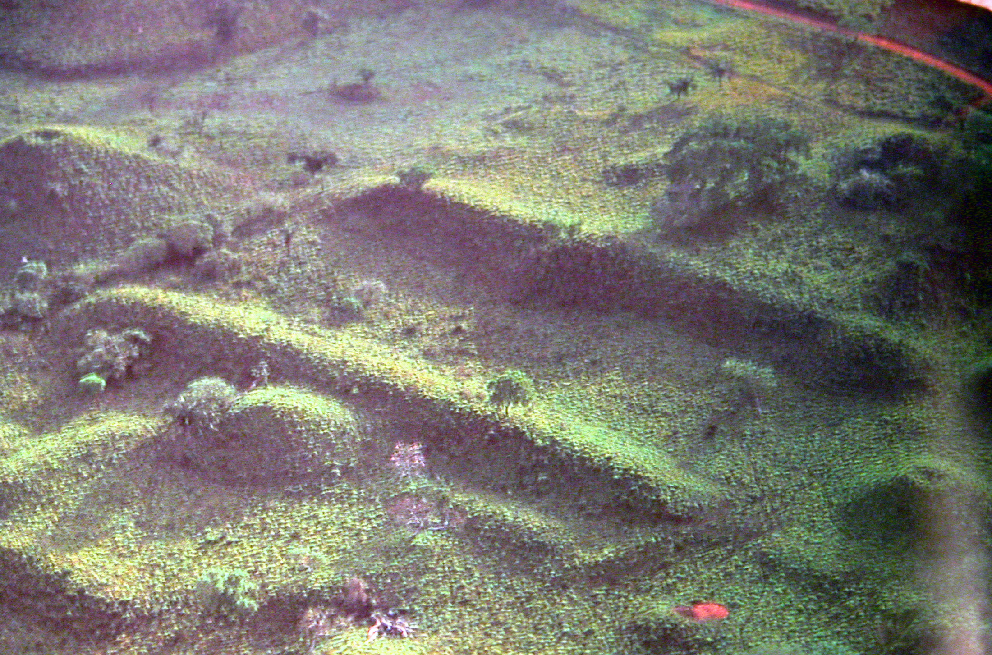
Olmec Ruins from the Air in Mexico

Slide 60
“The total quantity of treasures uncovered in Complex A (at the Olmec city of La Venta which was the second largest Olmec city), only a portion of which are described here, brings to mind the royal treasures of European monarchs or pharaonic tombs.”
Richard A. Diehl in The Olmecs: America’s First Civilization, 2004:74.
Notes:
I’m sorry that I do not have photos of the riches of the Olmec from this particular tomb at La Venta.
But remember the statement in The Book of Mormon we read a few minutes ago that at some time they would be “greatly prospered” by the hand of the Lord. It is an accurate description of the treasures that have been found in the Olmec cities such as La Venta. How many saw the Egyptian king Tut display when it was here a few years ago. Such wealth does not come when people are only subsistence farmers. The accumulation of wealth is made possible by business, government, trade, ie advanced, well organized and properous civilizations.

Slide 61
“In 1969 Rio Pesquero…was the site of one of the most spectacular Olmec discoveries ever made, when fishermen accidentally uncovered jadeite and serpentine objects in the river bottom. It soon became apparent that they had encountered an immense cache that included dozens of life-sized greenstone masks, at least 1,000 celts, as well as figurines, ornaments and ritual paraphernalia’. Richard A. Diehl in The Olmecs: America’s First Civilization, 2004:79.
Notes:
The rest of the story is that robbers stole this wonderful find before the government could move to protect it.

Slide 62
Archaeology Timeline
Mesoamerica Book of Mormon
pre-Olmec people 3114 BC Jaredite arrival
Pottery, planted crops 3000 BC Pottery, planted crops
Southwest deserts 2100 BC Great dearth
Over centuries Olmec nation, 1800 BC Over centuries Jaredites
pharaonic like treasures, highly blessed, great city in
great city in narrow neck narrow neck of land
Land southward not highly 1500 BC Land southward preserved
populated before 600 BC as wilderness
Now, metals by 1475 BC 1475 BC Metals, Jaredite always had
Now, writing by 650 BC 650 BC Writing, Jaredites always had
Olmec civilization ceased 300 BC Jaredite civilization ceased

Slide 63
Archaeology indicates that:
“One of ancient Mesoamerica’s great mysteries is the absence of significant human populations in Yucatan, Belize, and the Peten of Guatemala before 800 BC. continued:

Slide 64
Continued:
Earlier remains have been identified at various places in the northern Peten and Belize, but the entire area was very lightly settled until 600/500 BC.”
Richard A. Diehl in The Olmecs: America’s First Civilization, 2004:150.

Slide 65
“Slow, uneven population growth occurred from 1000 to 500 BC…. There are indications that this erratic population growth became an explosion after 550 B.C. The reasons for the apparent jump in numbers of people are obscure.”
R.E.W. Adams in Prehistoric America, revised edition, 1991:152-153.

Slide 66
Speaking of the Jaredites The Book of Mormon says:
“And they did preserve the land southward for a wilderness…”
Ether 4:68-70
Remember the lands of Mulek and Lehi were not highly populated until about 6 to 500 B.C.

Slide 68
Archaeology Timeline
Mesoamerica Book of Mormon
pre-Olmec people 3114 BC Jaredite arrival
Pottery, planted crops 3000 BC Pottery, planted crops
Southwest deserts 2100 BC Great dearth
Over centuries Olmec nation, 1800 BC Over centuries Jaredites
pharaonic like treasures, highly blessed, great city in
great city in narrow neck narrow neck of land
Land southward not highly 1500 BC Land southward preserved
populated before 600 BC as wilderness
Now, metals by 1475 BC 1475 BC Metals, Jaredite always had
Now, writing by 650 BC 650 BC Writing, Jaredites always had
Olmec civilization ceased 300 BC Jaredite civilization ceased
NOW means that at this time the archaeologists have evidence of Olmec metals as early
as 1475 BC. With further current searching they may well find earlier evidence.

Slide 69
What does The Book of Mormon say about metals during Jaredite history?
“Wherefore he came to the hill Ephraim, and he did moulten out of the hill, and made swords out of steel….” Ether 3:34 (shortly after their arrival in the promised land)

Slide 70
“And they did work all manner of ore, and they did make gold, and silver, and iron, and brass, and all manner of metals; and they did dig it out of the earth; wherefore they did cast up mighty heaps of earth to get ore, of gold, and of silver, and of iron and of copper.” (About 1500 BC)
        Ether 4:71

Slide 71
“And they did make all manner of tools to till the earth, both to plow and to sow, to reap and to hoe, and also to thrash. And they did make all manner of tools with which they did work their beasts. And they did make all manner of weapons of war.” (About 1500 B.C.) Ether 4:74-76
Notes:
From the descriptions of their civilization it is obvious that the Jaredites used metal shortly after their arrival in the promised land. It is later, about 1500 BC that the BoM tells the many different ways it was used.

Slide 72
What does archaeology indicate about metals for the Olmecs?
Ilmenite and magnetite were used to make mirrors in Oaxaca about 1475 B.C.
Robert Flannery in Archaeology, Vol.2, 1970:149.

Slide 73
“Pierre Agrinier found native iron ore deposits, a workshop littered with thousands of broken and partially worked ilmenite and magnetite blocks, chert drills and other tools, and even a fragment from an iron ore mirror….” Richard A. Diehl in The Olmecs: America’s First Civilization, 2004:133.

Slide 74
“Ann Cyphers and her colleagues uncovered two workshops containing tons of small rectangular [iron] “beads” perforated with conical holes…. The sheer quantity of objects turned up by Cyphers suggest they may have had some other use as well.” Richard A. Diehl in The Olmecs: America’s First Civilization, 2004:93.

Slide 75
“The most spectacular Olmec iron ore creations are large, beautifully polished, parabolic concave ‘mirrors’….”
continued:

Slide 76
Continued:
The concavity on the front is as carefully ground as many modern optical lenses, and the optical qualities of some allow them to be used to ignite fires and project ‘camera lucida’ images on flat surfaces.”
Richard A. Diehl in The Olmecs: America’s First Civilization, 2004:93-94

Slide 77
“Although the Olmecs had a Stone Age technology, they did work the iron ores magnetite, hematite, and ilmenite into beads, mirrors, and at least one marvelous little human figurine….”
Richard A. Diehl in The Olmecs: America’s First Civilization, 2004:93.

Slide 78
The archaeologists just told us that the Olmec were of stone age technology. Yet they could make these marvelous metal mirrors and figurines. Why should we not assume that they could make hoes, plows, thrashing machines and weapons of war as required by Book of Mormon history?

Slide 79
Remember that just because something has not been found does not mean it was not a part of the society. Most metals do not last. I remember being in Mexico in a fort built by the Spanish. What we saw was that the metal cannons were almost paper thin. Over 200 years the metal had almost wasted away. So, what would happen to most metals of 3 to 5,000 years ago?

Slide 80
Archaeology Timeline
Mesoamerica Book of Mormon
pre-Olmec people 3114 BC Jaredite arrival
Pottery, planted crops 3000 BC Pottery, planted crops
Southwest deserts 2100 BC Great dearth
Over centuries Olmec nation, 1800 BC Over centuries Jaredites
pharaonic like treasures, highly blessed, great city in
great city in narrow neck narrow neck of land
Land southward not highly 1500 BC Land southward preserved
populated before 600 BC as wilderness
Now, metals by 1475 BC 1475 BC Metals, Jaredite always had
Now, writing by 650 BC 650 BC Writing, Jaredites always had
Olmec civilization ceased 300 BC Jaredite civilization ceased
NOW means that at this time the archaeologists have evidence of Olmec writing as early
as 650 BC. With further current searching they may well find earlier evidence.
Notes:
NOW means that at this time archaeologists have evidence of writing by 650 BC. With further searching the archaeologists may find earlier writing.

Slide 81
What does The Book of Mormon tell us about their ability to write?
According to Ether the Jaredites had the ability to write throughout their history. Writing, or the keeping of records, is mentioned many times in the record.

Slide 82
Archaeology says:
“Today we know that writing and calendrics can be traced back to 650 B.C. at La Venta.” Their calendars “included a 260 day ritual almanac . . . and the 365 day solar or ‘Vague Year’….”
Richard A. Diehl in The Olmecs: America’s First Civilization,2004:95.

Slide 83
Once again, the dates for Olmec writing have been pushed back by archaeologists several centuries. Given time archaeologists may discover further evidence to prove that the Olmecs had writing even earlier than 650 B.C. which will mirror Book of Mormon history even more accurately.

Slide 84
Archaeology Timeline
Mesoamerica Book of Mormon
pre-Olmec people 3114 BC Jaredite arrival
Pottery, planted crops 3000 BC Pottery, planted crops
Southwest deserts 2100 BC Great dearth
Over centuries Olmec nation, 1800 BC Over centuries Jaredites
pharaonic like treasures, highly blessed, great city in
great city in narrow neck narrow neck of land
Land southward not highly 1500 BC Land southward preserved
populated before 600 BC as wilderness
Now, metals by 1475 BC 1475 BC Metals, Jaredite always had
Now, writing by 650 BC 650 BC Writing, Jaredites always had
Olmec civilization ceased 300 BC Jaredite civilization ceased

Slide 85
The Book of Mormon details the demise of the Jaredites.
According to Glenn Scotts’ timeline, fifteen kings later (maybe three to four hundred years) the Jaredites end as a nation in final exterminating battles. This occurs a century or two before the time Christ comes to the Nephites.

Slide 86
Archaeology says
“It is now apparent that by the beginning of the Late Preclassic (400 B.C. to A.D. 100) . . . Olmec presence . . . ceased.”
Morley and Brainerd, revised by Robert J. Sharer, in The Ancient Maya, 4th edition, 1983:65.

Slide 87
“Having dated the Olmec decline, what might account for it…? Whatever environmental changes occurred, the demise of Olmec culture was ultimately a cultural process that reflected human actions and responses…. But what happened to the people?”
Richard A. Diehl in The Olmecs: America’s First Civilization, 2004:82.

Slide 88
Yes, it was “human actions and responses” that destroyed the people. The Book of Mormon gives this history.
“Yea, there had been slain two millions of mighty men, and also their wives and their children.”
Ether 6:22, 73

Slide 90
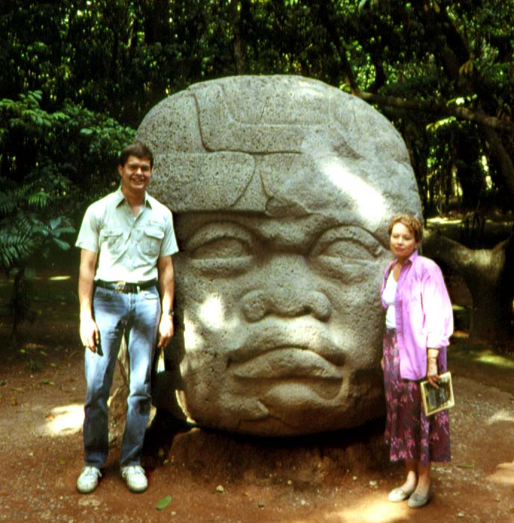
OLMEC Colossal Head, La Venta Park
Notes:
Before we tell you more about the Olmec timeline, let’s look at some of what is left from their civilization.

Slide 91
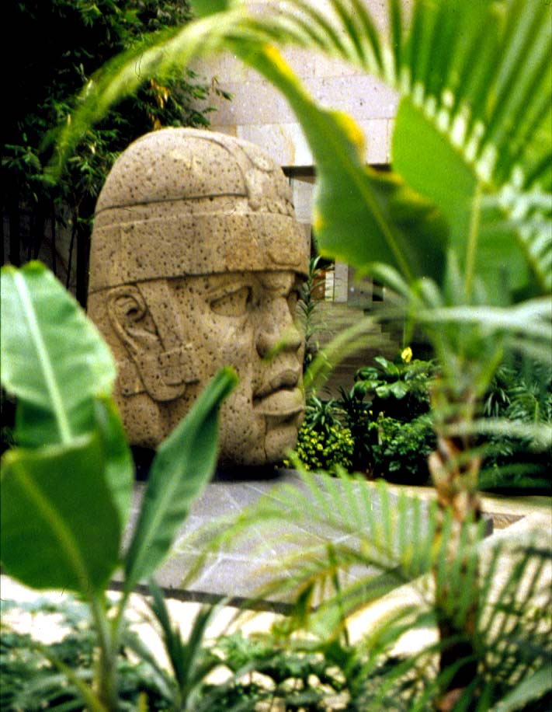
OLMEC Colossal Head, Jalapa Museum

Slide 92
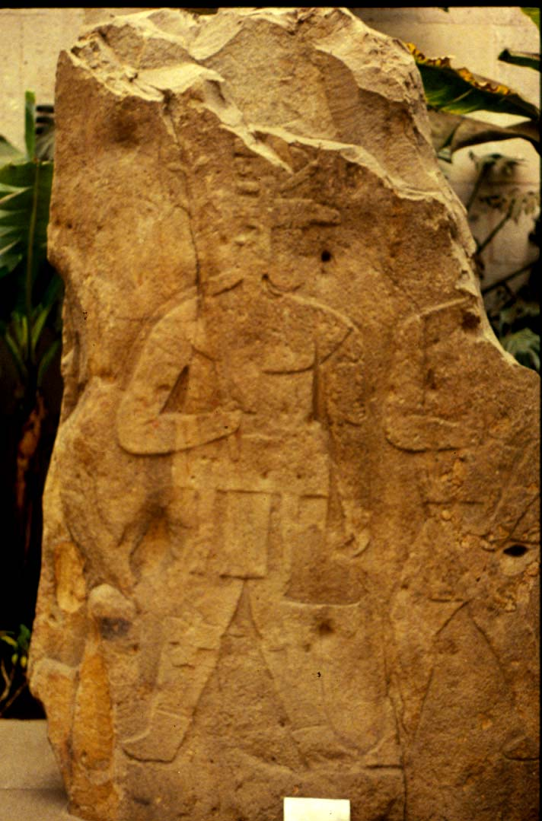
Large Stone Carving, La Venta

Slide 93
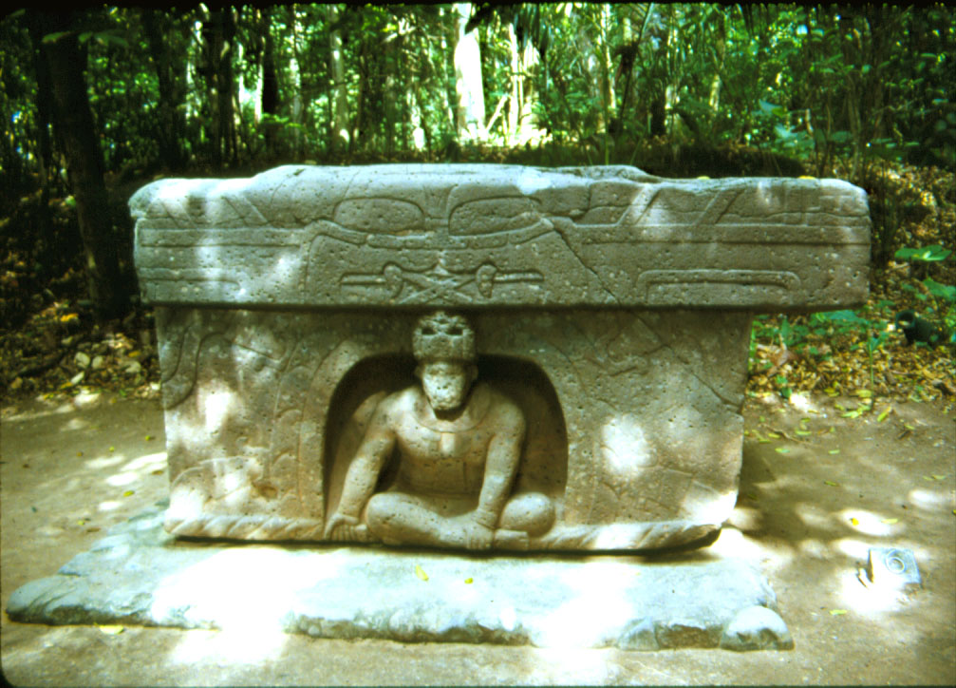
Stone Altar at La Venta Park

Slide 94
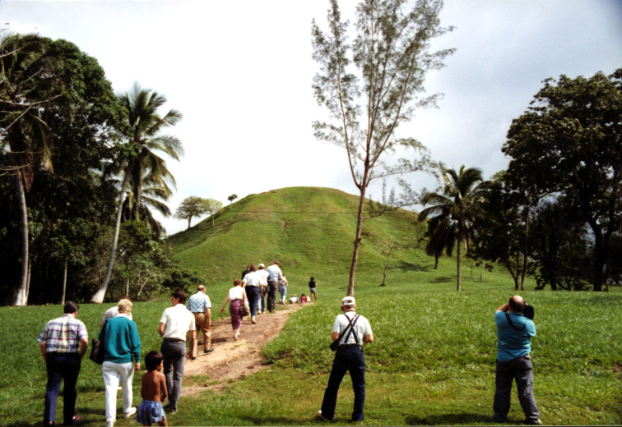
Tour Group at La Venta’s largest pyramid

Slide 95
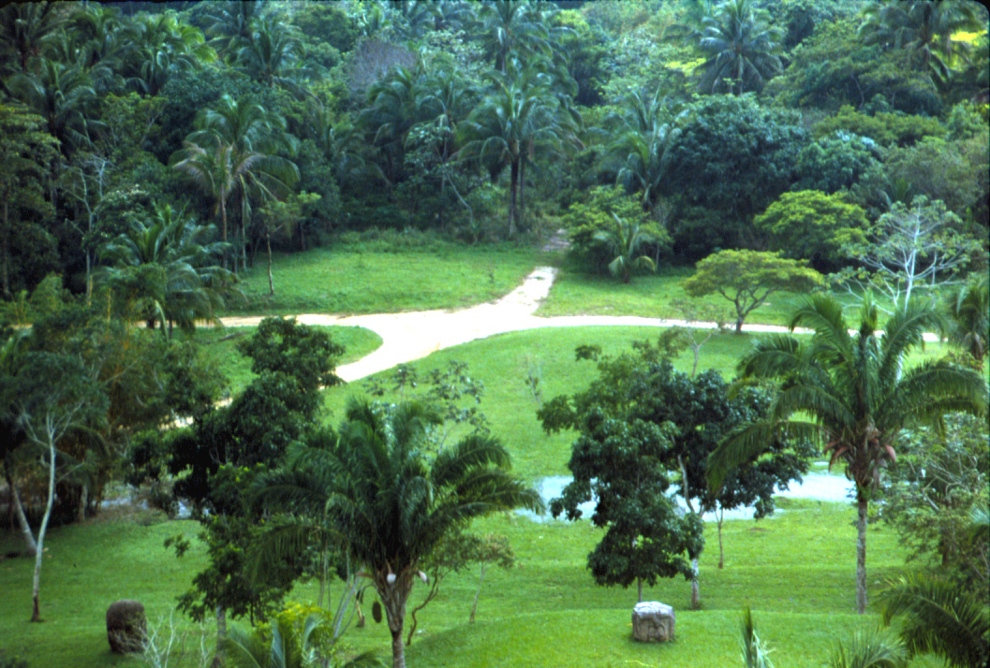
La Venta from top of pyramid

Slide 96
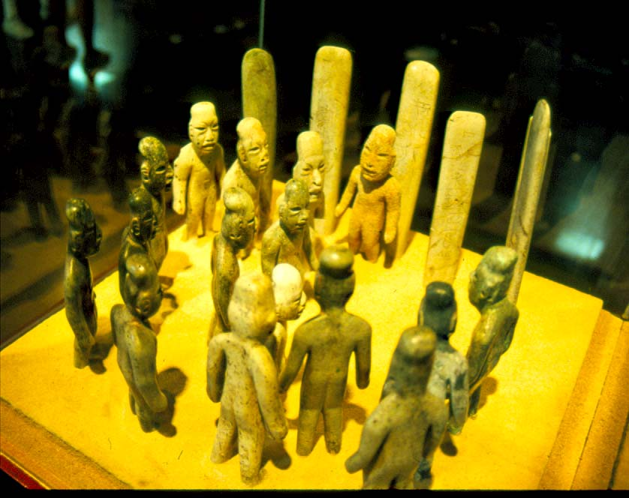
OLMEC Jade Figurines, La Venta Park

Slide 97
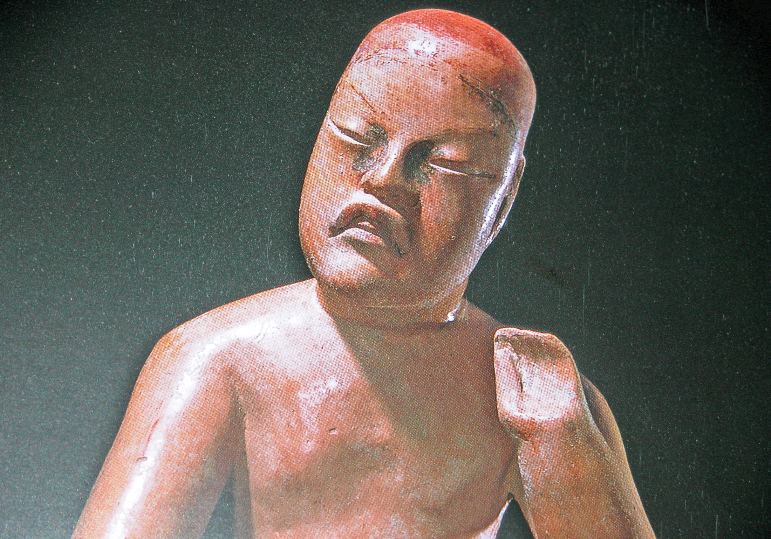
OLMEC Ceramic

Slide 98
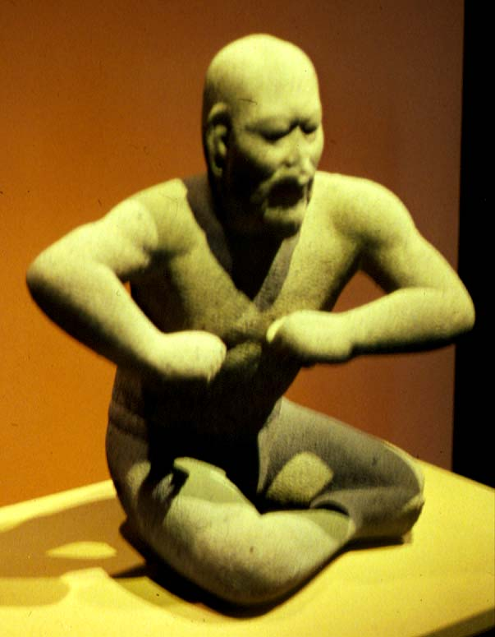
OLMEC Wrestler, National Museum

Slide 99
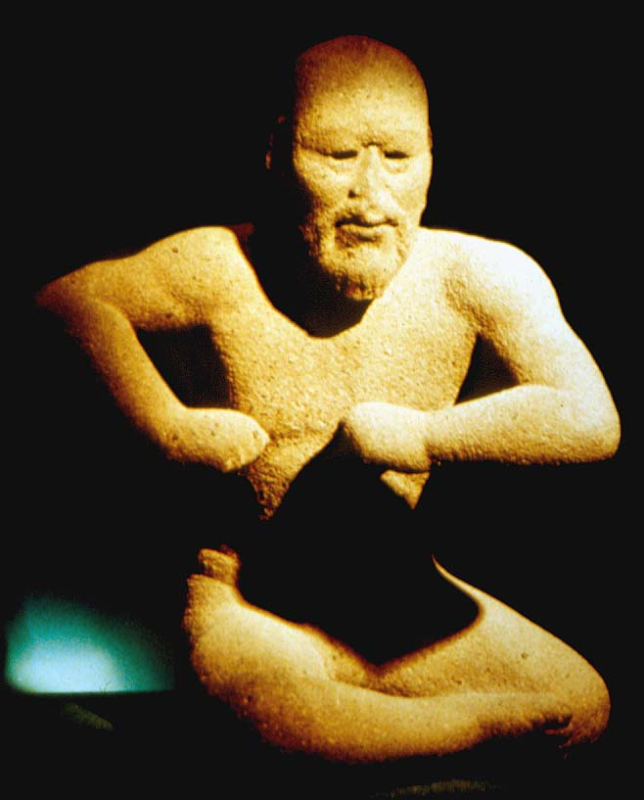
OLMEC Wrestler, National Museum

Slide 100
By now I trust you have begun to see and understand eight major parallels between the Jaredite and Olmec civilizations. Let’s look at them once more.

Slide 101
Archaeology Timeline
Mesoamerica Book of Mormon
pre-Olmec people 3114 BC Jaredite arrival
Pottery, planted crops 3000 BC Pottery, planted crops
Southwest deserts 2100 BC Great dearth
Over centuries Olmec nation, 1800 BC Over centuries Jaredites
pharaonic like treasures, highly blessed, great city in
great city in narrow neck narrow neck of land
Land southward not highly 1500 BC Land southward preserved
populated before 600 BC as wilderness
Now, metals by 1475 BC 1475 BC Metals, Jaredite always had
Now, writing by 650 BC 650 BC Writing, Jaredites always had
Olmec civilization ceased 300 BC Jaredite civilization ceased

Slide 102
Up until a few years ago archaeological evidence did not match The Book of Mormon record. Now it continues to converge so that Jaredite and Olmecs histories will have parallel timelines.

Slide 103
The Book of Mormon
has not changed.
So where do we find
Jaredite history?
MESOAMERICA

Slide 104
Underlining and coloring of words in this presentation has been done by the author to show emphasis.
This Power Point presentation is available for anyone to use. Please show it using “presenters mode.” That way you will have access to the notes that go with some of the material.
If you have questions contact me.
Note also that it is under copy write. This means that if you change this material from what I have done you must let your viewers know what you have changed.
                Lyle L. Smith
                smith.lyle@usa.net

Slide 105
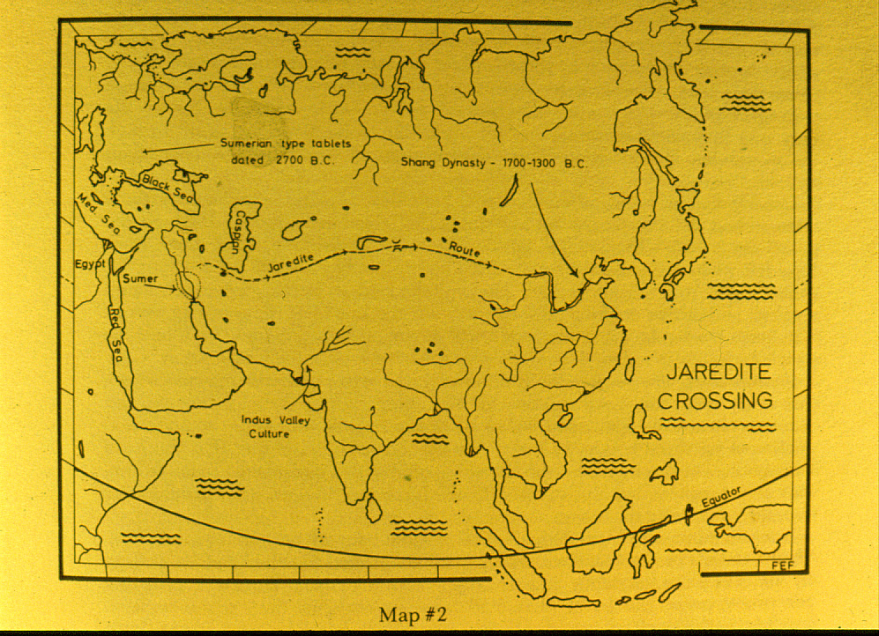

Slide 106
Archaeology Timeline
Mesoamerica Book of Mormon
pre-Olmec people 3114 BC Jaredite arrival
Pottery, planted crops 3000 BC Pottery, planted crops
Southwest deserts 2100 BC Great dearth
Over centuries Olmec nation, 1800 BC Over centuries Jaredites
pharaonic like treasures, highly blessed, great city in
great city in narrow neck narrow neck of land
Land southward not highly 1500 BC Land southward preserved
populated before 600 BC as wilderness
Now, metals by 1475 BC 1475 BC Metals, Jaredite always had
Now, writing by 650 BC 650 BC Writing, Jaredites always had
Olmec civilization ceased 300 BC Jaredite civilization ceased

